Slide 1
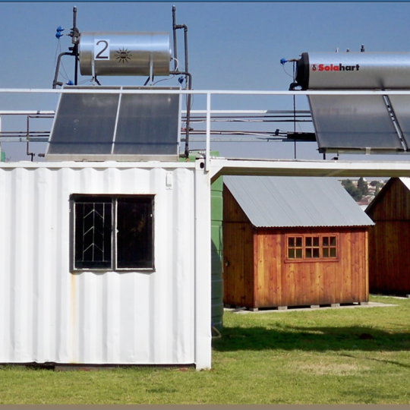
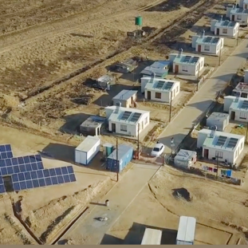
Clarification Meeting for E2816GXMWP
The provision of maintenance services and technical support on Regenerative Air Heaters and Auto Variable Pitch Axial Flow Fans and Centrifugal Fans for 14 (fourteen) Generation coal fired power stations on an “as and when required” basis for a period of 5 (five) years.
Date: 04 June 2026
Presented by: Commercial

Slide 2
Agenda
Description | Responsibility
Opening and welcome and introduction | Asanda Mzileni
Declaration of Interest | All
Safety and Evacuation | All
Commercial (RFP highlights) | Asanda Mzileni
Technical | Ntebogeng Mogudi
Finance | Indiphile Cengimbo
Supplier Development, Localisation and Industrialisation | Phindile Mbonambi
Safety | Florence Pooe
Quality | Sipho Sambo
General | All
Closing | Asanda Mzileni
Notes:
Managing SHE incidents is an Eskom requirement and legal requirements. It is not a company requirement or legal requirement, but also a moral obligation. You wouldn’t want to work in a company that damages the environment, as we know that we need to prevent envornmental damage for the benefit of future generation, same goes for the injuries, you would want to work for the company where people get injured at work and nothing is done about it. There are various pieces of legislation outlining the requirements to manage incidents. For someone to be able to mange an incident they need to be equiped with the information, this goes for both employees and managers. If is for this reason that we need to have continuous awareness of the requirements for incident awareness.

Slide 3
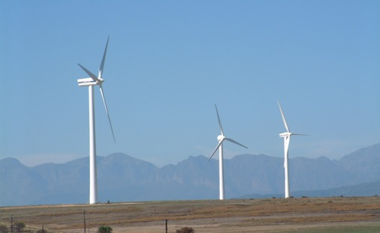
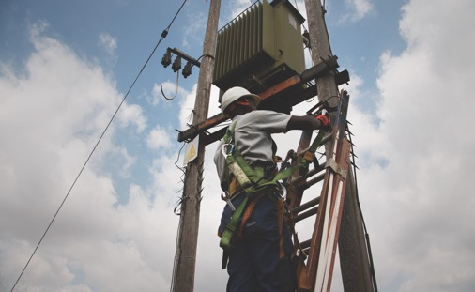
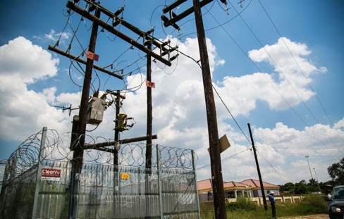
Commercial

Slide 4
Contacts & Important dates
Tender number/ RFP number | E2816GXMWP
Issue date | 15 May 2026
Closing date and time | 31 July 2026 at 10h00 a.m. South African Standard Time (SAST)
Tender validity period | 12 (twelve) weeks from the closing date and time.
Clarification meeting (non – compulsory) | 04 June 2026 through Microsoft Teams at 10h00 a.m.
Tenders are to be submitted electronically via Eskom E- tendering site by the stipulated closing date and time. | Please note it is the responsibility of the supplier to ensure that the tender submission is submitted before the closing time.
Deadline for clarifications | 24 July 2026
Eskom representative | Asanda Mzileni asanda.mzileni@eskom.co.za
Notes:
Managing SHE incidents is an Eskom requirement and legal requirements. It is not a company requirement or legal requirement, but also a moral obligation. You wouldn’t want to work in a company that damages the environment, as we know that we need to prevent envornmental damage for the benefit of future generation, same goes for the injuries, you would want to work for the company where people get injured at work and nothing is done about it. There are various pieces of legislation outlining the requirements to manage incidents. For someone to be able to mange an incident they need to be equiped with the information, this goes for both employees and managers. If is for this reason that we need to have continuous awareness of the requirements for incident awareness.

Slide 5
Tender Data:
Clause Number from Standard Conditions of Tender | Tender Data
Eskom's right to accept or reject any tender. | The tender shall be for the [whole /part] of the contract. The contract will be awarded to a maximum of 3 (three) suppliers for Air Heaters (Cluster 1 to 3) and to a maximum of 3 (three) suppliers for Fans (Cluster 4 to 6).
Air Heaters
Cluster 1 | Cluster 2 | Cluster 3
Kendal | Camden | Matla
Matimba | Grootvlei | Majuba
Medupi | Kusile | Hendrina
Tutuka | Lethabo | Kriel
Arnot | Duvha
Fans
Cluster 4 | Cluster 5 | Cluster 6
Kendal | Camden | Matla
Matimba | Grootvlei | Majuba
Medupi | Kusile | Hendrina
Tutuka | Lethabo | Kriel
Arnot | Duvha

Slide 6
Tender Data:
Clause Number from Standard Conditions of Tender | Tender Data
2.1 Eligibility | Tenderers (whether a single company or an incorporated or unincorporated joint venture or consortium) must meet the eligibility criteria stated in the Tender Data. The tenderer, or any of its principals, must not be under any restriction to do business with Eskom or State-Owned Companies. Tenderers are ineligible to submit a tender if: 1. Tenderers have the nationality of a country on any international sanctions list. A tenderer shall be found to have the nationality of a country if the tenderer is a national or is constituted, incorporated, or registered and operates in conformity with the provisions of the laws of that country. This criterion shall also apply to the determination of the nationality of proposed subcontractors or suppliers for any part of the Contract including related services.

Slide 7
Tender Data:
Clause Number from Standard Conditions of Tender | Tender Data
2.1 Eligibility | 2. Tenderers submit more than one [tender/proposal] either individually or as a partner in a joint venture (JV) or consortium, except on an E-Tendering system where there is a limit size (The upload size per document is 500 megabytes and total submission is restricted to 4 gigabytes). 3. Tenders submitted by a joint venture or consortium where the JV/consortium agreement does not explicitly state that the parties of the JV or consortium shall be jointly and severally liable for the execution of the Contract in accordance with the Contract terms.

Slide 8
Tender Data:
Clause Number from Standard Conditions of Tender | Tender Data
2.1 Eligibility | 4. A Tenderer must not have a conflict of interest. All Tenderers found to have a conflict of interest shall be disqualified. Prima facie evidence that a tenderer has a conflict of interest with one or more parties in this [tendering/RFP] process is: a) they have a controlling partner or majority shareholder in common; or b) they have a relationship with each other, directly or through common third parties, that puts them in a position to have access to information about or influence on the tender of another tenderer, or to influence the decisions of the Employer regarding this bidding process;

Slide 9
Tender Data:
Clause Number from Standard Conditions of Tender | Tender Data
2.1 Eligibility | 5. Tenders signed by non-authorised persons. 6. Any tenderer that is restricted by National Treasury. 7. Any tenderer on the Tender Defaulters list. 8. Any tenderer and/or its director/s that is restricted by Eskom. 9. A tenderer that sub-contracts 100% of the Scope of Work Eskom will disqualify tenderers that are found not to have met the eligibility criteria.

Slide 10
Step 1 - Tender submission 1/10
Mandatory requirements
  If you do not submit mandatory tender returnables as at stipulated deadlines will be disqualified.
Reference | Returnable From Suppliers | Returnable required at Tender closing (disqualifiable)* | Returnable required at Tender closing. (Non-disqualifiable) ** | Returnable required prior to Contract Award.
Basic Compliance | Submit a complete tender with commercial, financial and technical information. The price list needs to be submitted in PDF and in excel format (The upload size per document is 500 megabytes and total submission is restricted to 4 gigabytes). | √
Notes:
Managing SHE incidents is an Eskom requirement and legal requirements. It is not only a company requirement or legal requirement, but also a moral obligation. You wouldn’t want to work in a company that damages the environment, as we know that we need to prevent envornmental damage for the benefit of future generation, same goes for the injuries, you would want to work for the company where people get injured at work and nothing is done about it. There are various pieces of legislation outlining the requirements to manage incidents. For someone to be able to mange an incident they need to be equiped with the information, this goes for both employees and managers. If is for this reason that we need to have continuous awareness of the requirements for incident awareness.

Slide 11
Step 1 - Tender submission 2/10
Mandatory requirements
  If you do not submit mandatory tender returnables as at stipulated deadlines will be disqualified.
Reference | Returnable From Suppliers | Returnable required at Tender closing (disqualifiable)* | Returnable required at Tender closing. (Non-disqualifiable) ** | Returnable required prior to Contract Award.
Annexure A | Authorisation Form |  | √
Annexure B | Acknowledgement Form |  | √
Annexure C | Tenderers Particulars |  | √
Annexure D | Integrity Pact Declaration form |  | √
Notes:
Managing SHE incidents is an Eskom requirement and legal requirements. It is not only a company requirement or legal requirement, but also a moral obligation. You wouldn’t want to work in a company that damages the environment, as we know that we need to prevent envornmental damage for the benefit of future generation, same goes for the injuries, you would want to work for the company where people get injured at work and nothing is done about it. There are various pieces of legislation outlining the requirements to manage incidents. For someone to be able to mange an incident they need to be equiped with the information, this goes for both employees and managers. If is for this reason that we need to have continuous awareness of the requirements for incident awareness.

Slide 12
Step 1 - Tender submission 3/10
Reference | Returnable From Suppliers | Returnable required at Tender closing (disqualifiable)* | Returnable required at Tender closing. (Non-disqualifiable) ** | Returnable required prior to Contract Award.
Annexure E | CPA for local goods/services (if applicable). |  | √
Annexure F | CPA(IG) for imported goods/services (if applicable). |  | √
Annexure G1-G2 | SBD 6.2 -Declaration certificate for local production and content and Annexures G1 and G2 |  | √
Annexure H (applicable for all suppliers including Foreign suppliers) | SBD 1- to be completed and submitted by all tenderers. |  |  | √
Notes:
Managing SHE incidents is an Eskom requirement and legal requirements. It is not only a company requirement or legal requirement, but also a moral obligation. You wouldn’t want to work in a company that damages the environment, as we know that we need to prevent envornmental damage for the benefit of future generation, same goes for the injuries, you would want to work for the company where people get injured at work and nothing is done about it. There are various pieces of legislation outlining the requirements to manage incidents. For someone to be able to mange an incident they need to be equiped with the information, this goes for both employees and managers. If is for this reason that we need to have continuous awareness of the requirements for incident awareness.

Slide 13
Step 1 - Tender submission 4/10
Reference | Returnable From Suppliers | Returnable required at Tender closing (disqualifiable)* | Returnable required at Tender closing. (Non-disqualifiable) ** | Returnable required prior to Contract Award.
# Annexure I | SBD 6.1- Preference Points Claim Form in terms of PPPFA 2022 regulations |  | √
Annexure J | SBD 4 – Bidders Disclosure |  | √
E-tendering Help Manual acknowledgement form. |  |  | √
Notes:
Managing SHE incidents is an Eskom requirement and legal requirements. It is not only a company requirement or legal requirement, but also a moral obligation. You wouldn’t want to work in a company that damages the environment, as we know that we need to prevent envornmental damage for the benefit of future generation, same goes for the injuries, you would want to work for the company where people get injured at work and nothing is done about it. There are various pieces of legislation outlining the requirements to manage incidents. For someone to be able to mange an incident they need to be equiped with the information, this goes for both employees and managers. If is for this reason that we need to have continuous awareness of the requirements for incident awareness.

Slide 14
Step 1 - Tender submission 5/10
Reference | Returnable From Suppliers | Returnable required at Tender closing (disqualifiable)* | Returnable required at Tender closing. (Non-disqualifiable) ** | Returnable required prior to Contract Award.
Additional Documents required in event of JV | Letter of intent to form a JV/consortium or Valid joint venture agreement confirming the rights and obligations of each of the joint venture partners and their profit-sharing ratios. |  | √
 | Separate written confirmation that the joint venture will operate as a single business entity (incorporated) for the duration of the contract or this may be included as an obligation within the JV agreement. |  | √
 | Details and confirmation of a single designated bank account in the name of the JV and independent of the individual JV partners, as set out in the joint venture agreement. |  |  | √
Notes:
Managing SHE incidents is an Eskom requirement and legal requirements. It is not only a company requirement or legal requirement, but also a moral obligation. You wouldn’t want to work in a company that damages the environment, as we know that we need to prevent envornmental damage for the benefit of future generation, same goes for the injuries, you would want to work for the company where people get injured at work and nothing is done about it. There are various pieces of legislation outlining the requirements to manage incidents. For someone to be able to mange an incident they need to be equiped with the information, this goes for both employees and managers. If is for this reason that we need to have continuous awareness of the requirements for incident awareness.

Slide 15
Step 1 - Tender submission 6/10
Reference | Returnable From Suppliers | Returnable required at Tender closing (disqualifiable)* | Returnable required at Tender closing. (Non-disqualifiable) ** | Returnable required prior to Contract Award.
# Specific Goals | A tenderer’s failure to submit proof that it meets the specific goals will not result in its disqualification. The tenderer will, however, be scored zero for Specific Goals for purposes of PPPFA scoring and ranking. | Refer to Annexure R - SDL&I.
Tax Clearance Certificates | A certified copy of a tax clearance certificate is required from foreign tenderers (with a footprint in South Africa but that are not registered on CSD and have not provided a SARS pin number) and local tenderers (that have not provided their SARS e-filing PIN number for verification by Eskom and/or their CSD profile / CSD number). Foreign suppliers with no footprint in South Africa must complete the SBD1 document; however, no proof of tax compliance is required. |  |  | √
Notes:
Managing SHE incidents is an Eskom requirement and legal requirements. It is not only a company requirement or legal requirement, but also a moral obligation. You wouldn’t want to work in a company that damages the environment, as we know that we need to prevent envornmental damage for the benefit of future generation, same goes for the injuries, you would want to work for the company where people get injured at work and nothing is done about it. There are various pieces of legislation outlining the requirements to manage incidents. For someone to be able to mange an incident they need to be equiped with the information, this goes for both employees and managers. If is for this reason that we need to have continuous awareness of the requirements for incident awareness.

Slide 16
Step 1 - Tender submission 7/10
Reference | Returnable From Suppliers | Returnable required at Tender closing (disqualifiable)* | Returnable required at Tender closing. (Non-disqualifiable) ** | Returnable required prior to Contract Award.
Tax Evaluation Questionnaire (if services contract and was included as annexure) | Evaluation questionnaire to determine whether a company, close corporation (CC) or Trust is a personal service provider for purposes of PAYE |  |  | √
Compliance with Employment Equity Act | To the extent that the tenderer falls within the definition of a “designated Employer” as contemplated in the Employment Equity Act 55 of 1998, the tenderer is required to furnish the Employer with proof of compliance with the Employment Equity Act, including proof of submission of the Employment Equity report to the Department of Labour. (South African tenderers only) |  |  | √
Notes:
Managing SHE incidents is an Eskom requirement and legal requirements. It is not only a company requirement or legal requirement, but also a moral obligation. You wouldn’t want to work in a company that damages the environment, as we know that we need to prevent envornmental damage for the benefit of future generation, same goes for the injuries, you would want to work for the company where people get injured at work and nothing is done about it. There are various pieces of legislation outlining the requirements to manage incidents. For someone to be able to mange an incident they need to be equiped with the information, this goes for both employees and managers. If is for this reason that we need to have continuous awareness of the requirements for incident awareness.

Slide 17
Step 1 - Tender submission 8/10
Reference | Returnable From Suppliers | Returnable required at Tender closing (disqualifiable)* | Returnable required at Tender closing. (Non-disqualifiable) ** | Returnable required prior to Contract Award.
CIDB (where applicable) | Valid proof of the required CIDB grading designation for the main contractor; JV and /or sub-contractor as may be required in the tender data at tender closing deadline or within 21 working days from the closing date of submission of tenders if this is agreed with the Employer. | √
NEC3 Term Services Contract Annexure P | NEC Contract completed. |  | √
Notes:
Managing SHE incidents is an Eskom requirement and legal requirements. It is not only a company requirement or legal requirement, but also a moral obligation. You wouldn’t want to work in a company that damages the environment, as we know that we need to prevent envornmental damage for the benefit of future generation, same goes for the injuries, you would want to work for the company where people get injured at work and nothing is done about it. There are various pieces of legislation outlining the requirements to manage incidents. For someone to be able to mange an incident they need to be equiped with the information, this goes for both employees and managers. If is for this reason that we need to have continuous awareness of the requirements for incident awareness.

Slide 18
Step 1 - Tender submission 9/10
Reference | Returnable From Suppliers | Returnable required at Tender closing (disqualifiable)* | Returnable required at Tender closing. (Non-disqualifiable) ** | Returnable required prior to Contract Award.
Pricing schedule - Annexure Q | Completed pricing schedule. For e-tendering price schedule needs to be submitted in PDF format. | √
 | and a copy in excel format. The upload size per document is 500 megabytes and total submission is restricted to 4 gigabytes. | √
Notes:
Managing SHE incidents is an Eskom requirement and legal requirements. It is not only a company requirement or legal requirement, but also a moral obligation. You wouldn’t want to work in a company that damages the environment, as we know that we need to prevent envornmental damage for the benefit of future generation, same goes for the injuries, you would want to work for the company where people get injured at work and nothing is done about it. There are various pieces of legislation outlining the requirements to manage incidents. For someone to be able to mange an incident they need to be equiped with the information, this goes for both employees and managers. If is for this reason that we need to have continuous awareness of the requirements for incident awareness.

Slide 19
Step 1 - Tender submission 10/10
Reference | Returnable From Suppliers | Returnable required at Tender closing (disqualifiable)* | Returnable required at Tender closing. (Non-disqualifiable) ** | Returnable required prior to Contract Award.
Functionality Evaluation - Annexure O and Attachment G | Functionality will carry a total weighting of 100%, with a minimum threshold of 80% - Mandatory Technical Evaluation. Qualitative Technical Evaluation. To be considered technically responsive, a service provider must achieve at least 80% in each of the following: Phase 1 - Desktop Assessment Phase 2 - Local Site Assessment | √
Notes:
Managing SHE incidents is an Eskom requirement and legal requirements. It is not only a company requirement or legal requirement, but also a moral obligation. You wouldn’t want to work in a company that damages the environment, as we know that we need to prevent envornmental damage for the benefit of future generation, same goes for the injuries, you would want to work for the company where people get injured at work and nothing is done about it. There are various pieces of legislation outlining the requirements to manage incidents. For someone to be able to mange an incident they need to be equiped with the information, this goes for both employees and managers. If is for this reason that we need to have continuous awareness of the requirements for incident awareness.

Slide 20
MANDATORY CONTRACTUAL REQUIREMENTS SUPPORTING EVIDENCE
Reference | Returnable From Suppliers | Returnable required at Tender closing (disqualifiable)* | Returnable required at Tender closing. (Non-disqualifiable) ** | Returnable required prior to Contract Award.
Mandatory Contractual Requirement | Proof of valid and current CSD Registration (CSD number/CSD Report) |  |  | √
Annexure R | Supplier Development Localisation & Industrialisation (SDL&I) Strategy. |  |  | √
Safety | OHS Tender Evaluation Criteria (High risk) |  |  | √
Quality | Category 1: Quality Requirements |  |  | √
Notes:
Managing SHE incidents is an Eskom requirement and legal requirements. It is not only a company requirement or legal requirement, but also a moral obligation. You wouldn’t want to work in a company that damages the environment, as we know that we need to prevent envornmental damage for the benefit of future generation, same goes for the injuries, you would want to work for the company where people get injured at work and nothing is done about it. There are various pieces of legislation outlining the requirements to manage incidents. For someone to be able to mange an incident they need to be equiped with the information, this goes for both employees and managers. If is for this reason that we need to have continuous awareness of the requirements for incident awareness.

Slide 21
MANDATORY CONTRACTUAL REQUIREMENTS SUPPORTING EVIDENCE
Reference | Returnable From Suppliers | Returnable required at Tender closing (disqualifiable)* | Returnable required at Tender closing. (Non-disqualifiable) ** | Returnable required prior to Contract Award.
Due Diligence/ financial analysis | Latest, approved (No draft annual financial statements or managements accounts are allowed for this process) annual financial statements of the tendering company (Not Parent or ultimate holding company) , including: Background to the company A signed director’s report. A signed auditor’s/reviewer’s/compiler’s/accounting officer’s report. Statement of financial position. Statement of comprehensive income. Statement of changes in equity. Statement of cash flows. Notes to the financial statements. |  |  | √
Notes:
Managing SHE incidents is an Eskom requirement and legal requirements. It is not only a company requirement or legal requirement, but also a moral obligation. You wouldn’t want to work in a company that damages the environment, as we know that we need to prevent envornmental damage for the benefit of future generation, same goes for the injuries, you would want to work for the company where people get injured at work and nothing is done about it. There are various pieces of legislation outlining the requirements to manage incidents. For someone to be able to mange an incident they need to be equiped with the information, this goes for both employees and managers. If is for this reason that we need to have continuous awareness of the requirements for incident awareness.

Slide 22
MANDATORY CONTRACTUAL REQUIREMENTS SUPPORTING EVIDENCE
Reference | Returnable From Suppliers | Returnable required at Tender closing (disqualifiable)* | Returnable required at Tender closing. (Non-disqualifiable) ** | Returnable required prior to Contract Award.
Due Diligence/ financial analysis | A signed copy of the public interest score (only applicable to South African entities that are not audited) Giving the actual score Indicating whether the company is owner managed or not Confirming whether the annual financial statements were externally prepared or not. Copies of the ITA34C for the current & previous years of assessment (only applicable to South African entities that are not audited) For unincorporated JV or a SPV, each partner in the JV or a SPV must submit its annual financial statements including all items listed above. |  |  | √
Notes:
Managing SHE incidents is an Eskom requirement and legal requirements. It is not only a company requirement or legal requirement, but also a moral obligation. You wouldn’t want to work in a company that damages the environment, as we know that we need to prevent envornmental damage for the benefit of future generation, same goes for the injuries, you would want to work for the company where people get injured at work and nothing is done about it. There are various pieces of legislation outlining the requirements to manage incidents. For someone to be able to mange an incident they need to be equiped with the information, this goes for both employees and managers. If is for this reason that we need to have continuous awareness of the requirements for incident awareness.

Slide 23
Please note:
    Failure to submit documents listed as mandatory for evaluation will result in disqualification.
    Kindly re-visit the websites regularly to confirm if there are any changes made in the Enquiry Documents.
    All clarification questions must be made in writing and will be co –ordinated only through Commercial.
    Kindly submit documents that are required prior to Contract Award at Tender stage, if possible, even though you will not be disqualified if you do not submit.

Slide 24
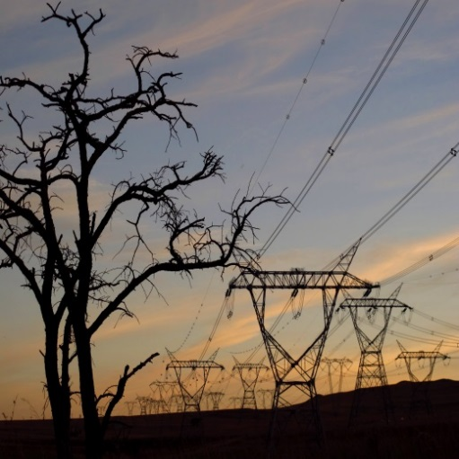
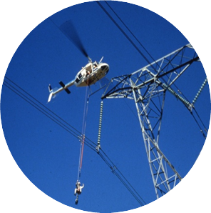
Questions?

Slide 25
Technical
Notes:
Facilitator: Please include additional slides – for example if you need more explanations or appropriate images!
To set up the Presenter view (where the facilitator can see the notes pane as well as the slides to come) do the following:
Open the Slide Show menu
Select the ‘Use Presenter View’ checkbox
On the drop down box next to ‘Show On:’ select the secondary monitor (….this is to say where the presenter view with notes pane etc. will display. Remember the primary monitor might be the screen in front of the training room. Play with this till you have the full screen slide show on the projector screen and the Presenter view on your laptop’s monitor.)
It might be necessary to repeat some of the steps.

Slide 26
Mandatory and Qualitative Technical Requirements:
    Overall Technical Evaluation Requirements:
    The technical evaluation will be carried out based on the Generation Tender Technical Evaluation Procedure- 240-168966153 rev 1.
    The Technical Evaluation Criteria for Airheaters is applicable for Cluster 1-3.
    The Technical Evaluation Criteria for Fans is applicable for Cluster 4-6.
    The Mandatory Technical Evaluation Criteria for Airheaters and Fans is listed in the invitation to tender letter under functionality/technical criteria documents required.
    The Qualitative Technical Evaluation Criteria for Airheaters and Fans is listed in Annexture O and Attachment G.
    The Tenderer only needs to submit the Mandatory and Qualitative Technical Evaluation Criteria for the specific clusters they are tendering for.

Slide 27
Mandatory and Qualitative Technical Requirements:
    Mandatory Evaluation Requirements:
    All mandatory criteria must be met by the tenderer to continue to the qualitative evaluation phase.

Slide 28
Mandatory and Qualitative Technical Requirements:
    Qualitative Evaluation Requirements:
The minimum weighted final score (threshold) required for a tender to be considered from a technical perspective is 80% for each of the Desktop (Phase 1) and Local Site Assessment (Phase 2).
Note: If the Eskom technical evaluation team has scored the service provider ≥ 80% for Phase 1 (Desktop assessment), Eskom will proceed with Phase 2 (Local Site assessment). If the technical evaluation team has scored Phase 1 < 80% for any service provider, the Eskom technical evaluation team will not proceed with Phase 2 (Local Site assessment) and the service provider will be classified as technically unacceptable.
If the Eskom technical evaluation team has scored the service provider ≥ 80% in Phase 2 (Local Site Assessment) the service provider will be deemed as technically acceptable.
Eskom will then proceed with Phase 3 (Local Site Capability Assessment) which will only be an on-site assessment of the contractor’s capacity and capability.
Phase 3 will not be scored but will be used to gauge the risk of the contractor’s resource capabilities.

Slide 29
Mandatory Technical Evaluation Criteria for Cluster 1 to 3 Air Pre-Heaters
 | Mandatory Technical Criteria Description | Reference to Technical Specification / Tender Returnable | Motivation for use of Criteria
1. | The tendering entity must submit a list which includes at least proof of 5 traceable individual power station references that adequately prove that the tenderer has designed, manufactured, and supplied Rotating Matrix and/or Rotating Hood Air Pre-Heaters for fossil-fired power stations with at least 200MW capacity per unit (two air pre-heaters) either locally or internationally. The following information must be supplied as a minimum: Client/Utility Name Boiler Size in MW Type of Air Pre-Heater Size and Diameter of Air Pre-Heater(s) Contract Numbers Start Date of Contract Completion Date of Contract/(Certificate of Completion) Upon request from Eskom the supplier may be required to supply the contact’s name and number for a specific reference listed. | Supply reference list containing all the required fields stipulated in the mandatory item description. The tenderer must have and installed base of Air Heaters. | To demonstrate an understanding of the installed base of the supplier involved in Maintaining Air Pre Heaters which will reduce the risk to Eskom. Capability and Experience Evaluation.
2. | Tendering companies shall submit a valid proof of accreditation to ISO 3834 Part 2. In the event of a Joint Venture the company (or companies) that will physically be executing the welding work must submit the valid proof of ISO 3834 Part 2 accreditation. | Proof of valid accreditation for ISO 3834 as prescribed in the 240-106628253 Eskom Welding Standard for Level 1 Equipment. | Quality Evaluation.

Slide 30
Mandatory Technical Evaluation Criteria for Cluster 4 to 6 Axial and Centrifugal Fans
 | Mandatory Technical Criteria Description | Reference to Technical Specification / Tender Returnable | Motivation for use of Criteria
1. | The tendering entity provides proof of their installed base of Axial Flow Fans with hydraulic auto-variable blade pitching that the company has designed, manufactured, and supplied in the range larger than 3000kW within at least the last 20 years. The list can be either local or international clients for the power generation sectors, mining or industrial sectors for the applicable size and must contain the following information and at least 5 examples: 1. Client/Utility Name 2. Boiler Size in MW 3. Fan Type 4. Fan Size 5. Fan Kilowatt Rating 6. Contract Numbers 7. Start Date of Contract 8. Completion Date of Contract/Certificate of Completion. Upon request from Eskom the supplier may be required to supply the contact’s name and number for a specific reference listed. | Supply reference list containing details relating to all the required fields stipulated in the mandatory item description. The tenderer must have and installed base of relevant Fans. | To demonstrate an understanding of the installed base of the supplier involved in Maintaining relevant Fans which will reduce the risk to Eskom. Capability and Experience Evaluation.
2. | The tendering entity provides proof of its installed base of Centrifugal Fans that he has designed, manufactured, and supplied in the range greater than 2000kW within at least the last 20 years. The list can be either local or international clients in the power generation, mining or industrial sectors for the applicable size and must contain the following information and at least 5 examples: 1. Client/Utility Name 2. Boiler Size in MW 3. Fan Type 4. Fan Size 5. Fan Kilowatt Rating 6. Contract Numbers 7. Start Date of Contract 8. Completion Date of Contract/(Certificate of Completion) Upon request from Eskom the supplier may be required to supply the contact’s name and number for a specific reference listed. | Supply reference list containing details relating to all the required fields stipulated in the mandatory item description. The tenderer must have and installed base of relevant Fans. | To demonstrate an understanding of the installed base of the supplier involved in Maintaining relevant Fans which will reduce the risk to Eskom. Capability and Experience Evaluation.
3. | Tendering companies shall submit a valid proof of accreditation to ISO 3834 Part 2. In the event of a Joint Venture the company or companies that will physically be executing the welding work must submit valid proof of accreditation. | Proof of valid accreditation for ISO 3834 as prescribed in the 240-106628253 Eskom Welding Standard for Level 1 Equipment. | Quality Evaluation.

Slide 31
Questions?

Slide 32
Finance
Notes:
Facilitator: Please include additional slides – for example if you need more explanations or appropriate images!
To set up the Presenter view (where the facilitator can see the notes pane as well as the slides to come) do the following:
Open the Slide Show menu
Select the ‘Use Presenter View’ checkbox
On the drop down box next to ‘Show On:’ select the secondary monitor (….this is to say where the presenter view with notes pane etc. will display. Remember the primary monitor might be the screen in front of the training room. Play with this till you have the full screen slide show on the projector screen and the Presenter view on your laptop’s monitor.)
It might be necessary to repeat some of the steps.

Slide 33
Step 3: Finance
Reference | Returnable From Suppliers | Returnable required at Tender closing (disqualifiable)* | Returnable required at Tender closing. (Non-disqualifiable) ** | Returnable required prior to Contract Award.
Pricing schedule - Annexure Q | Completed pricing schedule. For e-tendering price schedule needs to be submitted in PDF format. | √
 | and a copy in excel format. The upload size per document is 500 megabytes and total submission is restricted to 4 gigabytes. | √
Notes:
Managing SHE incidents is an Eskom requirement and legal requirements. It is not only a company requirement or legal requirement, but also a moral obligation. You wouldn’t want to work in a company that damages the environment, as we know that we need to prevent envornmental damage for the benefit of future generation, same goes for the injuries, you would want to work for the company where people get injured at work and nothing is done about it. There are various pieces of legislation outlining the requirements to manage incidents. For someone to be able to mange an incident they need to be equiped with the information, this goes for both employees and managers. If is for this reason that we need to have continuous awareness of the requirements for incident awareness.

Slide 34
Step 3: Finance
Finance\Attachment C - Resources Price List.xlsx
Revised Air Heater Activity Schedules (Finance Folder)
Finance\Fans Activity Schedules

Slide 35
Questions?

Slide 36
Supplier Development, Localisation and Industrialisation
Notes:
Facilitator: Please include additional slides – for example if you need more explanations or appropriate images!
To set up the Presenter view (where the facilitator can see the notes pane as well as the slides to come) do the following:
Open the Slide Show menu
Select the ‘Use Presenter View’ checkbox
On the drop down box next to ‘Show On:’ select the secondary monitor (….this is to say where the presenter view with notes pane etc. will display. Remember the primary monitor might be the screen in front of the training room. Play with this till you have the full screen slide show on the projector screen and the Presenter view on your laptop’s monitor.)
It might be necessary to repeat some of the steps.

Slide 37
Step 4: Supplier Development, Localisation and Industrialisation (Contractual Requirements)
Commercial\Annexure R -SDL & I Strategy - Regenerative Air Heaters and Auto Variable Pitch Axial Flow Fans and Centrifugal Fans.pdf

Slide 38
Questions?

Slide 39
SAFETY, HEALTH AND ENVIRONMENTAL (SHE)
Notes:
Facilitator: Please include additional slides – for example if you need more explanations or appropriate images!
To set up the Presenter view (where the facilitator can see the notes pane as well as the slides to come) do the following:
Open the Slide Show menu
Select the ‘Use Presenter View’ checkbox
On the drop down box next to ‘Show On:’ select the secondary monitor (….this is to say where the presenter view with notes pane etc. will display. Remember the primary monitor might be the screen in front of the training room. Play with this till you have the full screen slide show on the projector screen and the Presenter view on your laptop’s monitor.)
It might be necessary to repeat some of the steps.

Slide 40
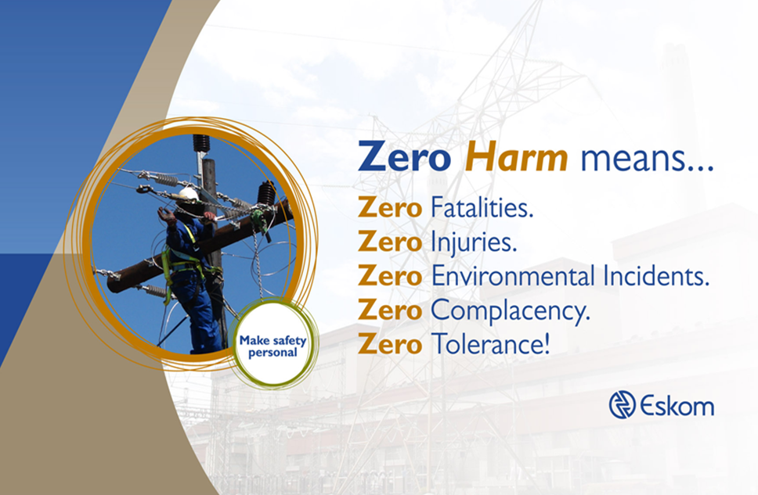
Zero Harm Value
Eskom will strive to ensure that zero harm befalls its employees, contractors, the public and the natural environment

Slide 41
Step 4: Safety Health and Environmental (SHE) (Contractual Requirements)
Safety\Annexure C1 OHS Tender Evaluation Regenerative Air Heaters.pdf

Slide 42
Questions?

Slide 43
QUALITY
Notes:
Facilitator: Please include additional slides – for example if you need more explanations or appropriate images!
To set up the Presenter view (where the facilitator can see the notes pane as well as the slides to come) do the following:
Open the Slide Show menu
Select the ‘Use Presenter View’ checkbox
On the drop down box next to ‘Show On:’ select the secondary monitor (….this is to say where the presenter view with notes pane etc. will display. Remember the primary monitor might be the screen in front of the training room. Play with this till you have the full screen slide show on the projector screen and the Presenter view on your laptop’s monitor.)
It might be necessary to repeat some of the steps.

Slide 44
Step 4: Quality (Contractual Requirements)
Quality\Supplier Quality Management_Cat 1_List of Returnables Rev 7.xlsx

Slide 45
Questions?

Slide 46
Closing
Returnables that are mandatory for evaluation will result in disqualification if not submitted at tender closing.
Closing deadline is 31 July 2026 at 10h00
Late Tenders will not be accepted.
Tenders are to be submitted electronically via Eskom E- tendering site by the stipulated closing date and time.

Slide 47
Thank You!

