Slide 1
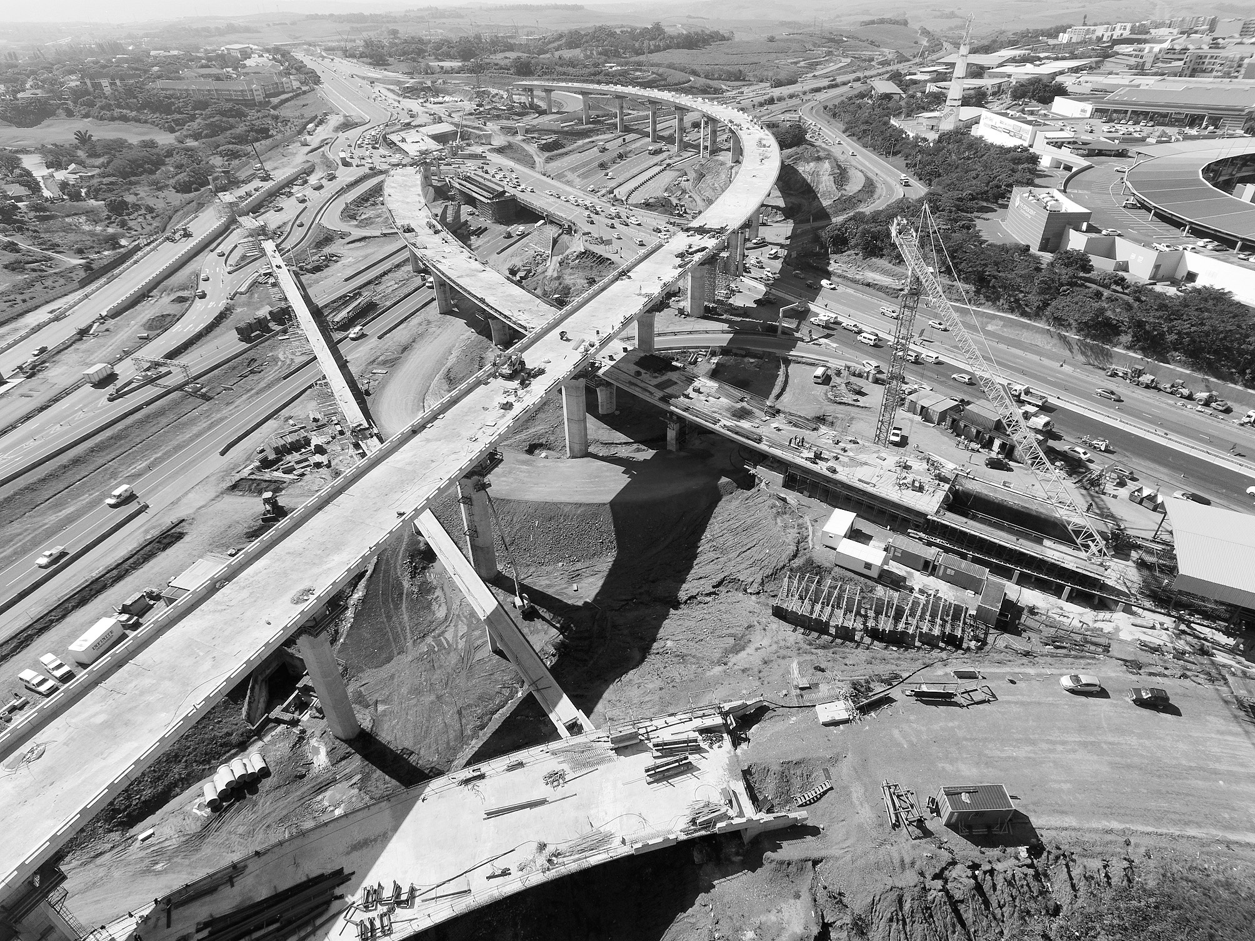

CLARIFICATION MEETING PRESENTATION :
SUB-CONTRACT TITLE:
GEOTECHNICAL INVESTIGATIONS FOR THE CONCEPT AND PRELIMINARY DESIGN FOR THE REALIGNMENT OF NATIONAL ROUTE 3, SECTIONS 3 AND 4, FROM CHOTA MOTALA INTERCHANGE (KM 12.86) TO CEDARA (KM1.6)
SUB-CONTRACT SANRAL N.003-034-2017/9D-PD1 D-SS
JUNE 2026
1

Slide 2

PROJECT TEAM
PROJECT | SUB-CONTRACT SANRAL N.003-034-2017/9D-PD1 D-SS
IMPLEMENTING AGENCY | SANRAL
EMPLOYER | V3 Consulting Engineers
PROJECT LEAD (V3) | Ferdi Boshoff
CONSULTANT | V3 Consulting Engineers

Slide 3
IMPORTANT DATES
SUBMISSION OF FORM A1.1 Tenderers must submit, via email, the duly completed Form A1.1 Certificate of Intention to Submit a Tender within seven (7) days from the tender advertisement date. Failure to submit this certificate would result in the tenderer not receiving addenda or additional issued information and may result in the tenderer being non-responsive. | 25 MAY 2026
LAST SUBMISSION OF QUERIES | 3 JUNE 2026
TENDER CLOSING DATE | 19 JUNE 2026

Slide 4
CONTENT
TENDER NOTICE AND INVITATION TO TENDER
COMPOSITION OF THE TENDER DOCUMENT
CONDITIONS OF TENDER
SUBMISSION REQUIREMENTS
EVALUATION PROCESS
PART C1: AGREEMENTS AND CONTRACT DATA
PART C2: PRICING DATA
PART C3: SCOPE OF WORKS
PART C4: SITE INFORMATION
4

Slide 5
TENDER NOTICE AND INVITATION TO TENDER
3

Slide 6
PART T1.1: TENDER NOTICE AND INVITATION TO TENDER
TENDER DOCUMENTS
Tender documents are available at no cost in electronic format downloaded from the SANRAL’s website by the following link https://www.nra.co.za/service-provider-zone/tenders/open-tenders/.
Tenderers must have access to MS Office ©2013 and Acrobat Adobe ©9.0, or similar compatible software.
TENDERER’S MEETING
There is no clarification meeting for this tender; only a tenderer’s clarification presentation is available from the SANRAL website
Any questions or clarifications can be emailed to
danie.dutoit@v3consulting.co.za
6

Slide 7
COMPLETION AND DELIVERY OF TENDERS
The closing time for receipt of tenders is 11:00am on Friday 19 June 2026.
Telegraphic, telephonic, telex, email, facsimile and late tenders will not be accepted.
Tenders may only be submitted in the format as stated in the Tender Data.
Requirements for sealing, addressing, delivery, opening and assessment of tenders are stated in the Tender Data.
Queries relating to issues arising from these documents may be addressed to:
E-mail: danie.dutoit@v3consulting.co.za
6

Slide 8
CLARIFICATION MEETING PRESENTATION
The onus rests with the tenderer to ensure that the representative reading or viewing this clarification briefing presentation and are appropriately qualified to understand all directives and clarifications given in the clarification briefing presentation.
The signature on the duly completed and signed Form A1 shall be considered proof that the tenderer read/viewed the whole clarification briefing presentation clearly understood all directives and clarification given in the clarification briefing presentation.
7

Slide 9
COMPOSITION OF THE TENDER DOCUMENT
8

Slide 10
COMPOSITION OF TENDER DOCUMENT
T1 Tendering Procedures | T2 Returnable Schedules | C1 Agreements and contract data | C2 Pricing data | C3 Scope of work | C4 Site information
T1.1 TENDER NOTICE AND INVITATION TO TENDER | T2.1 LIST OF RETURNABLE SCHEDULES | C1.1.FORMS OF OFFER AND ACCEPTANCE | C2.1 PRICING INSTRUCTIONS | SECTION A: STANDARD AMENDMENTS ISSUED BY SANRAL | C4.1 GENERAL DESCRIPTION OF THE PROJECT AND SITE
T1.2 TENDER DATA |  | C1.2 CONTRACT DATA | C2.2 PRICING SCHEDULE | SECTION B. PROJECT SPECIFICATION AMENDMENTS TO THE STANDARD SPECIFICATIONS AND ADDITIONAL SPECIFICATIONS | C4.2 GEOLOGY C4.3 PROGRAMME C4.5 SERVICES C4.6 ACCESS
 |  | C1.2.1 CONDITIONS OF CONTRACT (FIDIC) INCLUDES: PARTICULAR CONDITIONS AMENDMENTS |  | SECTION C: OCCUPATIONAL HEALTH AND SAFETY | C4.7 SETTING OUT C4.8 TRANSPORTATION OF SAMPLES
 |  | C1.2.2. APPENDIX TO TENDER: CONTRACT DATA – INFORMATION PROVIDED BY THE EMPLOYER |  | SECTION D ENVIRONMENTAL MANAGEMENT PLAN | C4.9 CONTRACTORS SITE CAMP C4.10 ACCOMODATION OF TRAFFIC
 |  | C1.2.3 APPENDIX TO TENDER: CONTRACT DATA – INFORMATION PROVIDED BY THE TENDERER |  |  | C4. 12 MANAGEMENT OF THE ENVIRONMENT C4.14 MANAGEMENT OF OH&S
 |  | C1.3 OTHER STANDARD FORMS |  |  | C5 ANNEXURES
10

Slide 11
TENDER IS MADE UP OF THE FOLLOWING DOCUMENTS :
Tender document in PDF
Clarification Presentation for Scope and Site Information in Pdf
Returnable Schedules A1 – E in MS word
Pricing Schedule and Summary of Pricing Schedule in MS Excel

Slide 12
CONDITIONS OF TENDER
11

Slide 13
T1.2 CONDITIONS OF TENDER
Note to tenderer:
The Conditions of Tender are the Standard Conditions of Tender as contained in SANS 10845-3:2015 Edition 1.
SANS 10845-3:2015 Edition 1 is obtainable from:
SABS Standards Division
1 Dr Lategan Road Groenkloof
Or
Private Bag X191 Pretoria
0001
Tel: +27 12 428 7911
website: www.sabs.co.za
12

Slide 14
SUBMISSION REQUIREMENTS
13

Slide 15
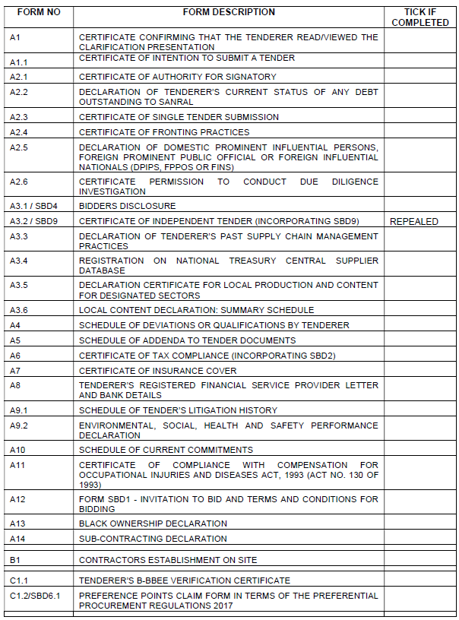
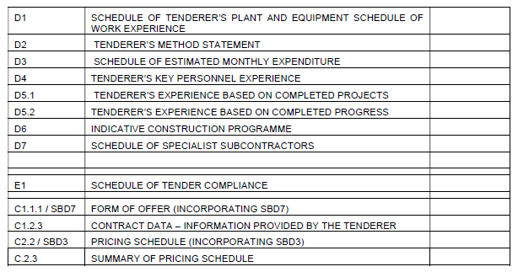
SCHEDULE OF TENDER COMPLIANCE
Ensure all tender returnables are duly signed and relevant proof is attached to the form where applicable.
SCAN and PDF onto FlashDrive

Slide 16


PART T2: RETURNABLE SCHEDULES

Slide 17
T2.1 LIST OF RETURNABLE SCHEDULES
Notes to tenderer:
Returnable schedules have been separated into the following categories:
- Forms, certificates and schedules for completion by the tenderer for use in the quantitive and qualitative evaluation of the tender (Forms A to E)
- A list of all returnable documents for completion by the tenderer (Form E1)
Failure to submit fully completed relevant returnable documents may render such a tender offer unresponsive.
Tenderers shall note that their signature appended to each returnable form represents a declaration that they vouch for the accuracy and correctness of the information provided.
Notwithstanding any check or audit conducted by or on behalf of the Employer, the information provided in the returnable documents is accepted in good faith and as justification for entering into a contract with a tenderer. If subsequently any information is found to be incorrect such discovery shall be taken as wilful misrepresentation by that tenderer to induce the contract. In such event:

Slide 18
T2.1 LIST OF RETURNABLE SCHEDULES
a. the Employer shall inform the tenderer and give the tenderer an opportunity to make representations within 14 days as to why the tender submitted should not be disqualified and as to why the tenderer should not be restricted by the National Treasury from conducting any business with any organ of state for a period not exceeding 10 years;
b. if the Employer has already entered into a contract with the Tenderer, the Employer
has the discretionary right under FIDIC Particular Condition 15.2(g) to terminate the contract.
These forms must be completed in non-erasable ink and any alterations made prior to
tender closure countersigned by an authorised signatory.

Slide 19
T2.1 LIST OF RETURNABLE SCHEDULES
Form | Format | How to submit | Envelope
A1-A13 B1 C1.1 C1.2 D1 – D7 | PDF | Complete and sign where applicable. Scan the completed form and attach the supporting document to the form where required to do so. (D8 Not required) | (ONE ENVELOPE)
E1 | PDF | Complete and sign where applicable. Scan the completed form. (Please use form as intended; double check your submission when completing this form – do not just tick all the boxes).
C.1 | PDF | Complete and sign where applicable. Scan the completed form.
C2.2 C2.3 | PDF and EXCEL | Complete, print, sign and scan and submit .pdf AND Submit completed Excel file separately
18

Slide 20
T2.1 LIST OF RETURNABLE SCHEDULES
Only the following needs to be submitted electronically on flash drive marked with the contract number, project name and name of Tenderer, in the following order:
- Form of Offer (signed and scanned as .pdf)
- All returnable forms and schedules (signed and scanned as .pdf)
- Pricing Schedule (scanned copy in .pdf and copy in Excel)
19

Slide 21

RETURNABLE SCHEDULE
FORM A1.1
CERTIFICATE OF INTENTION TO SUBMIT A TENDER

Slide 22
FORM A2.1: CERTIFICATE OF AUTHORITY FOR SIGNATORY
The signatory for the tenderer
The board of directors/partners resolution.
Shall confirm his/her authority
Tendering company’s letterhead
Dully signed and dated
2. In the event of a joint venture, a certificate is required from each member of the JV clearly setting out:
- authority for signatory,
- undertaking to formally enter into a joint venture contract should an award be made to the joint venture,
- name of designated lead member of the intended joint venture, as required by tender condition 4.13.2.
3. The resolution in form A2.1 is given as an example of an acceptable format for authorisation, but submission of this page with the example completed shall not be accepted as authorisation of the tenderer’s signatory.

Slide 23
FORM A2.2: DECLARATION OF TENDERER’S CURRENT STATUS OF ANY DEBT
OUTSTANDING TO SANRAL

Slide 24
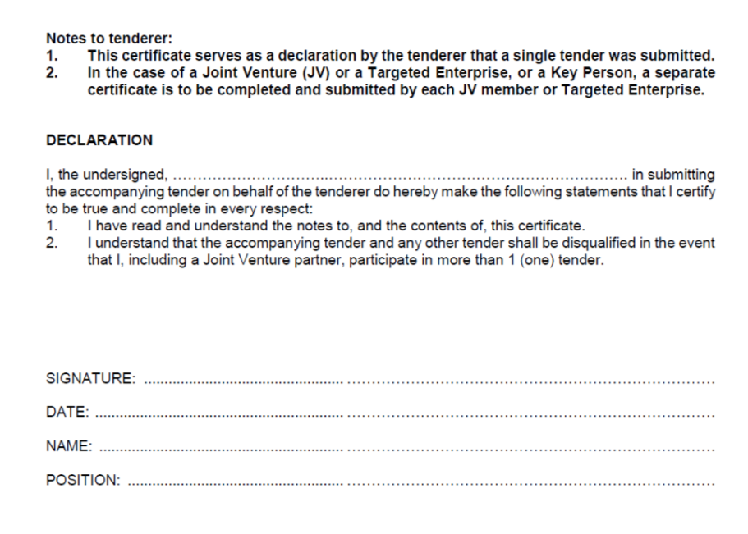
FORM A2.3: CERTIFICATE OF SINGLE TENDER SUBMISSION

Slide 25
RETURNABLE SCHEDULE A3.4 – REGISTRATION ON NATIONAL TREASURY CENTRAL SUPPLIER DATABASE
The tenderer shall provide a scanned copy in pdf of the Active Supplier Listing on the National Treasury Central Supplier Database. (www.treasury.gov.za). In the case of a joint venture (JV), the tenderer shall provide scanned copies in pdf of the Active Supplier Listing on the National Treasury Central Supplier Database for each member of the JV.
Name of the Contractor: …..……………………………………………………………………………….
CSD Master Registration Number (Supplier Number): ………………………………………..
Supplier Commodity: ………………………………………………………………………………………….
Delivery Location: ……………………………………………………………………………………………

Slide 26
EVALUATION PROCESS
20

Slide 27
4.1.1 ELIGIBILITY CRITERIA
Item | Description | Required
a | Registration on National Treasury Central Supplier Database | FORM A3.4
b | Criteria for preferential procurement | B-BBEE certificate in compliance with Tender Data 5.11.8

Slide 28
4.1.1 ELIGIBILITY CRITERIA CRITERIA FOR PREFERENTIAL PROCUREMENT
Tenderers that have a B-BBEE contributor status level of 1, 2, 3, or 4.
Tenderers shall submit a valid B-BBEE certificate in compliance with Tender Data 5.11.8 as proof of eligibility.
Failure to satisfy all the eligibility criteria is a breach of the Conditions of Tender and as such, results in a non-eligible tender.

Slide 29
4.1.1 B-BBEE REQUIREMENTS
PLEASE NOTE THE FOLLOWING NON-COMPLIANCE TO BBBEE REQUIREMENTS WILL LEAD TO DISQUALIFICATION FROM FURTHER EVALUATION:
For a start-up company (business registered within 12 months of the tender closing date); if the total tendered price exceeds R6m then the Tenderer MUST submit a Qualifying Small Enterprise (QSE) BBBEE scorecard (not sworn affidavit) if the total tendered price is up to R25m.
If a start-up company submits a QSE BBBEE certificate it MUST indicate that it is a start-up company on the certificate.
For unincorporated JV certificates, the size of the company must be indicated on the JV certificate (e.g EME,QSE,etc.)
JV BBBEE certificates MUST be project specific (e.g project number or description)
TENDERERS THAT ARE SUBMITTING A SWORN AFFIDAVIT AS PROOF OF BBBEE STATUS MUST USE THE ACSC TEMPLATE AS PROVIDED IN THE NEXT SLIDE. FAILURE TO USE THIS TEMPLATE WILL RESULT IN DISQUALIFICATION FROM FURTHER EVALUATION.

Slide 30
FINANCIAL EVALUATION
The procedure for the evaluation of responsive tenders is Method 3.
If two or more tenderers score an equal total number of points and these tenders are also the highest ranked tenders, the tender with the highest preference points will be recommended for award.
If functionality is part of the evaluation process and two or more tenderers score equal total points and equal preference points, the tenderer that scored the highest points for functionality will be recommended for award.
If two or more tenderers score equal total points in all respects, the tenderer to be recommended for award will be decided by the drawing of lots.
The financial proposals for the tenders that achieved the minimum quality criteria will evaluated on financial and preferential as follows :

Slide 31
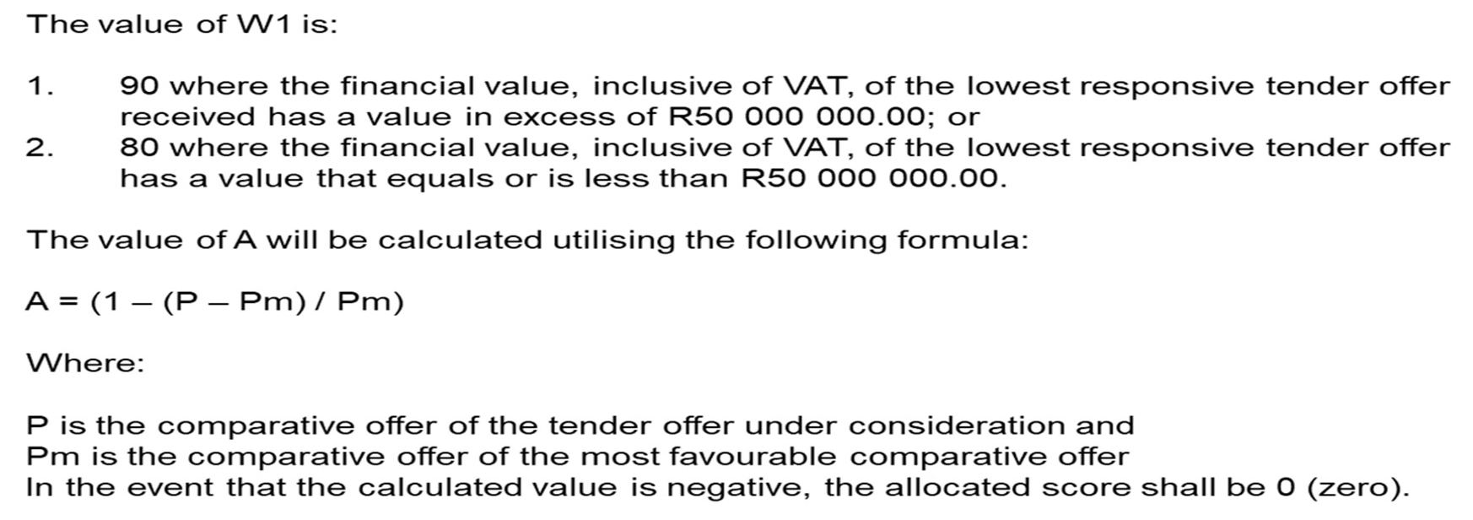
FINANCIAL EVALUATION
The financial proposals for the tenders that achieved the minimum quality criteria will evaluated on financial and preferential as follows :
Up to 100 minus W1 tender evaluation points will be awarded to tenderers who submit responsive tenders and who are found to be eligible for the preference claimed. Points are based on a tenderer’s scorecard measured in terms of the Broad-Based Black Economic Empowerment Act (B-BBEE, Act 53 of 2003) and the Regulations (2017) to the Preferential Procurement Policy Framework Act (PPPFA, Act 5 of 2000).

Slide 32
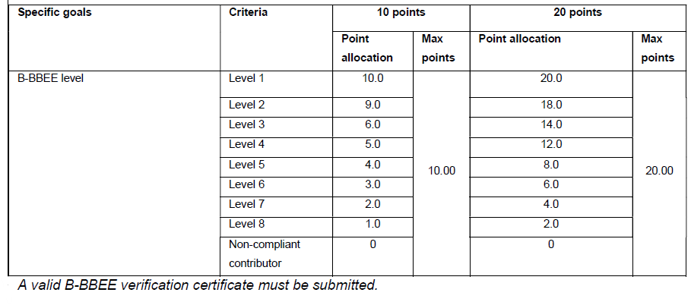
FINANCIAL EVALUATION
Preferential Points awarded will be according to a tenderer’s B-BBEE status level of contributor and summarised in the table below:

Slide 33
5.13 Conditions of Tender
KEY PERSONNEL

Slide 34
RETURNABLE SCHEDULE D4 – TENDERER’S KEY PERSONNEL EXPERIENCE
The tenderer shall provide details of qualifications and previous experience required for his key personnel on this project.
Technical/Managerial Experience :
List only the most recent 3 projects of the key staff that the tenderer considers relevant to the specified scope of works for each of the above key personnel

Slide 35
RETURNABLE SCHEDULE D5.1 – TENDERER’S EXPERIENCE BASED ON COMPLETED PROJECTS
1. The tenderer shall provide details of previous experience required for this project and a letter from the employer stating their performance.
2. The Tenderer must have satisfactorily completed (at least completed as a prime contractor, joint venture member, management contractor or subcontractor) a minimum number of three (3) similar contracts matching the subject project’s scope of work, between 1st January 2015 and tender submission deadline.

Slide 36

PART C1: AGREEMENTS & CONTRACT DATA
41

Slide 37
PART C1: AGREEMENTS & CONTRACT DATA
C1.2.1 CONDITIONS OF CONTRACT
The Conditions of Contract for Construction (1999 edition) published by the Federation Internationale des Ingenieurs-Conseils (FIDIC), as amended, shall apply to this contract.

Slide 38
PART C1: AGREEMENTS & CONTRACT DATA
Notes to tenderer
Should a tenderer wish to offer a different period of completion than that specified by the Employer, it shall be submitted as an alternative offer on a separate Form of Offer.
If more than one alternative tender is submitted each shall be numbered and submitted on a separate Form of Offer duly completed and signed.

Slide 39
PART C1: AGREEMENTS & CONTRACT DATA
C1.1.1 FORM OF OFFER
  Ensure that amount in words corresponds with amount in figures on the Pricing Schedule
  Ensure that Preference Claimed is completed
  Ensure that Form of Offer is signed by authorised person and two witnesses.

Slide 40
PART C1: AGREEMENTS & CONTRACT DATA
C1.2.2 APPENDIX TO TENDER: CONTRACT DATA INFORMATION PROVIDED BY THE EMPLOYER
Item | Cl No | Data
Retention money: |  | N/A
Target Area(s) | B1.3 (xvi) | For targeted Labour: uMngeni and Msunduzi Local Municipalities

Slide 41
PART C2: PRICING DATA
41

Slide 42
PART C2: PRICING DATA
C2.1 PRICING INSTRUCTIONS
  Measurement and payment shall be in accordance with the relevant provisions of the Standard Specifications for Sub-surface Investigations (2010) issued by SANRAL as amend in Scope of Works
C2.2 PRICING INSTRUCTIONS
  - Refer to Excel file for the detailed pricing schedules

Slide 43
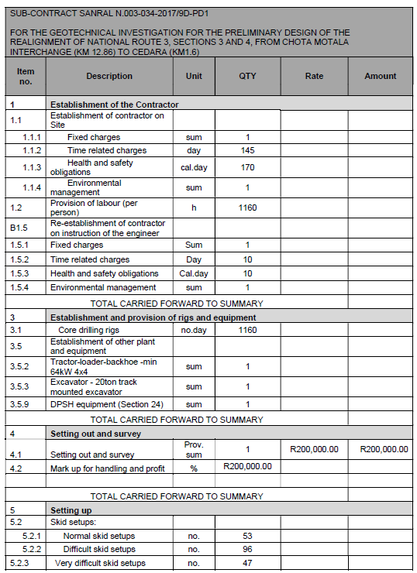
PART C2: PRICING DATA

Slide 44
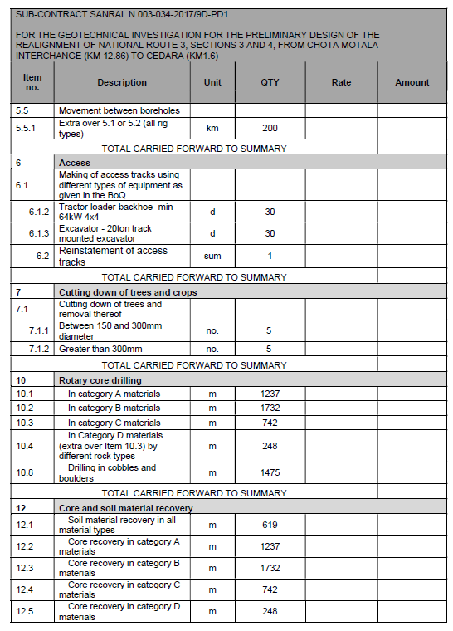
PART C2: PRICING DATA

Slide 45
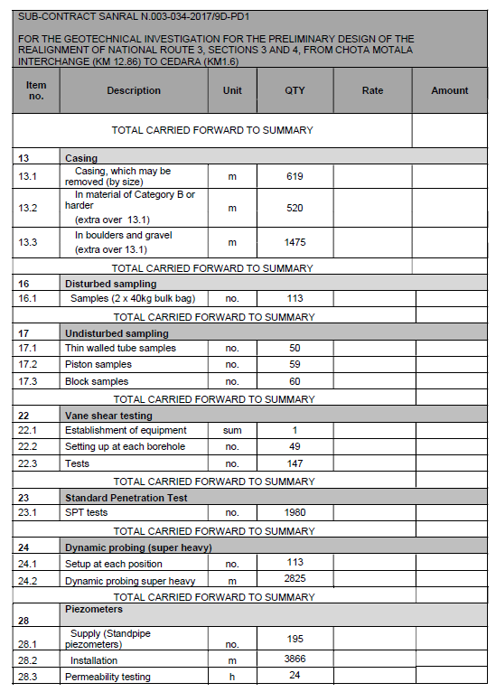
PART C2: PRICING DATA

Slide 46
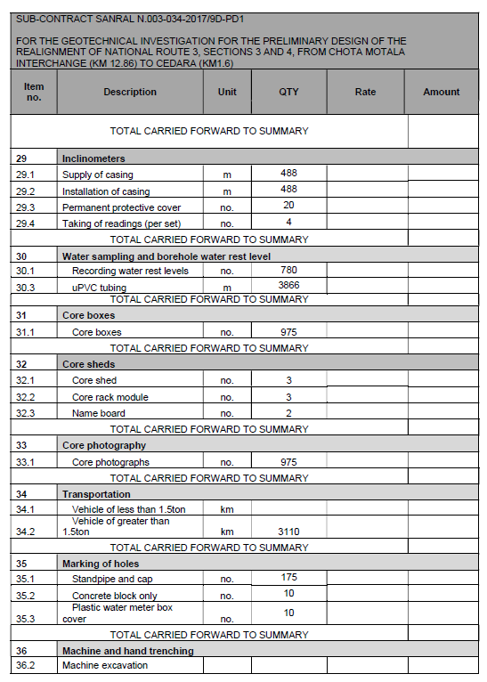
PART C2: PRICING DATA

Slide 47
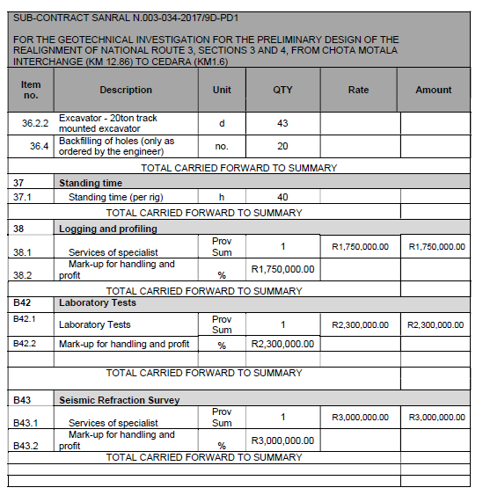
PART C2: PRICING DATA

Slide 48
PART C3: SCOPE OF WORK
41

Slide 49
PART C3: SCOPE OF WORKS
BACKGROUND
The South African National Roads Agency SOC Limited (SANRAL) is undertaking the conceptual and
preliminary design of the upgrading of National Route 3 Sections 3 and 4, from Chota Motala Interchange (Km 12.86) To Cedara (Km 1.6). As part of the upgrading, a bypass route has been proposed to provide an alternative route which will allow vehicles to travel at a safe and efficient speed on the freeway.
Proposed Bypass Routes: Route 12 and Route 13
Option 12 starts at km 18.44 at the N3 Chota Motala Road Interchange which leaves the N3 climbing and deviating slightly to the right immediately past the interchange and turning further right, skirting the southern boundary of Woodlands Township and continues further uphill to the eastern side of the Pietermaritzburg basin whilst climbing the escarpment to Hilton. The route ties back into the existing N3 alignment at 0.4 km after the Hilton Interchange and ends at the N3 Section 4 at the Cedara Interchange common end point. The length of this route from Chota Motala Interchange to Cedara Interchange is 16.14 km and entails the upgrading of the existing N3 formation (2.04 km) and widening to accommodate additional lanes and the rerouting (14.10 km) of Town Hill portion via the eastern valley slopes of the Pietermaritzburg Basin.
Option 13 follows the same alignment as Option 12, except this route diverges to the left at km 8.0 and
skirts the southwestern boundary of the Ferncliff Nature Reserve, then turns back to re-join the alignment of Option 12 at km 12.4 after the reserve, adding 0.4 km to the length of the route.

Slide 50
PART C3: SCOPE OF WORKS
Proposed Bypass Options
Option 12 | Option 13
Start: Chota Motala Interchange Deviates right past interchange Passes south of Woodlands Township Follows eastern slopes of Pietermaritzburg basin Climbs toward Hilton and rejoins N3 End: Cedara Interchange | Start: Same as Option 12 Follows same alignment initially Diverges at Km 8.0 Skirts Ferncliff Nature Reserve Rejoins Option 12 at Km 12.4 End: Cedara Interchange
Project Details: Total Length: 16.14 km Existing Upgrade: 2.04 km New Route: 14.10 km | Project Details: Slightly longer route (~+0.4 km) Similar structure with environmental deviation

Slide 51
PART C3: SCOPE OF WORKS
Objective: Conduct geotechnical investigations to support the concept and preliminary design for the realignment of National Route 3 (Sections 3 & 4).
Activities Required:
  Drilling boreholes at specified locations along the alignment.
  Sampling and logging of soil and rock strata.
  In‑situ testing (e.g., SPT, permeability tests).
  Laboratory testing of recovered samples.
Deliverables:
  Borehole logs and test results.
  Geotechnical report summarizing findings.
  Recommendations for foundation design and slope stability.
Compliance: Work must follow SANRAL’s Standard Specifications for Subsurface Investigations (2010).
Timeline: Approximate project duration is 9 months.

Slide 52
PART C3: SCOPE OF WORKS
Summary of Borehole Drilling Quantities for Viaducts
Bridge No. | Chainage | Minimum No. of Boreholes | Average Depth (m) | Total Depth (m)
1 | km0.6 - km1.5 | 15 | 18 | 270
2 | km1.85 - km2.55 | 16 | 18 | 288
3 | km2.8 - km3.05 | 7 | 18 | 126
4 | km3.7- km4.15 | 10 | 18 | 180
5 | km4.55 - km6.1 | 33 | 23 | 759
6 | km7.8 - km8.45 | 6 | 23 | 138
7 and 8 | km9.4 - km11.1 | 21 | 29 | 609
9 | km11.4 - km12.1 | 8 | 29 | 232
10 | km13.1 - km13.8 | 15 | 35 | 525
Totals |  | 131 | - | 3127
NOTE: SPTs are required every 1.5m in soft material.

Slide 53
PART C3: SCOPE OF WORKS
Summary of Borehole Drilling and Inspection Pit Quantities for Cuts and Fills
No. | Chainage | Length (m) | Appoximate Height (m) | Minimum No. of IP | Minimum No. of BH | BH Depth (m) | Total BH Depth (m) | Total IP Depth (m)
CUT SLOPES
1 | km1.5 -km1.8 | 300 | 28 | 6 | 6 | 41 | 246 | 30
2 | km2.55 - km2.8 | 250 | 17 | 5 | 4 | 23 | 92 | 25
3 | km3.05 - km3.4 | 350 | 16 | 7 | 4 | 23 | 92 | 35
4 | km6.1 - km6.4 | 300 | 17 | 6 | 3 | 23 | 69 | 30
5 | km6.8 - km7.8 | 1000 | 34 | 20 | 10 | 46 | 460 | 100
6 | km8.45 - km8.7 | 250 | 23 | 4 | 4 | 29 | 116 | 20
FILL SLOPES
1 | km3.4 - km3.8 | 400 | 10 | 8 | 5 | 18 | 90 | 40
2 | km4.15 - km4.55 | 400 | 15 | 8 | 5 | 12 | 60 | 40
3 | km6.4 - km6.8 | 400 | 20 | 8 | 5 | 18 | 90 | 40
4 | km8.7 - km9.4 | 700 | 37 | 14 | 6 | 12 | 72 | 70
5 | km11.1 - km11.4 | 300 | 28 | 6 | 5 | 23 | 115 | 30
6 | km12.1 - km12.4 | 300 | 25 | 6 | 7 | 29 | 203 | 30
Totals |  |  |  | 98 | 64 | - | 1705 | 490
NOTE: SPTs are required every 1.5m in soft material.

Slide 54
PART C3: SCOPE OF WORKS
PROGRAMME
The following assumptions have been made regarding the duration of the drilling programme:
  6 working days per week
  8 No. drilling rigs working consecutively
  2 weeks to establish on site and 2 weeks to de-establish on site
  7m per day per rig drilled
It is envisaged that all inspection pits and seismic surveys shall be carried out within the same time period as the borehole drilling.

Slide 55
PART C3: SCOPE OF WORKS
Estimated contractors work programme
Month | Week | Establishment | Drilling, Inspection Pits, Siesmic Surveys | De-estab | Logging and Profling
 |  | Duration in Weeks
1 | 1 | 1
 | 2 | 2
 | 3 |  | 1
 | 4 |  | 2
2 | 5 |  | 3
 | 6 |  | 4
 | 7 |  | 5 |  | 1
 | 8 |  | 6 |  | 2
3 | 9 |  | 7 |  | 3
 | 10 |  | 8 |  | 4
 | 11 |  | 9 |  | 5
 | 12 |  | 10 |  | 6
4 | 13 |  | 11 |  | 7
 | 14 |  | 12 |  | 8
 | 15 |  | 13 |  | 9
 | 16 |  | 14 |  | 10
5 | 17 |  | 15 |  | 11
 | 18 |  | 16 |  | 12
 | 19 |  | 17 |  | 13
 | 20 |  | 18 |  | 14
6 | 21 |  | 19 |  | 15
 | 22 |  | 20 |  | 16
 | 23 |  | 21 |  | 17
 | 24 |  | Shutdown |  | Shutdown
7 | 25 |  | Shutdown |  | Shutdown
 | 26 |  | Shutdown |  | Shutdown
 | 27 |  | 22 |  | 18
 | 28 |  | 23 |  | 19
8 | 29 |  | 24 |  | 20
 | 30 |  | 25 |  | 21
 | 31 |  |  | 1 | 22
 | 32 |  |  | 2 | 23
9 | 33 |  |  |  | 24
 | 34 |  |  |  | 25
 | 35 |  |  |  | 26
 | 36

Slide 56
PART C4: SITE INFORMATION
41

Slide 57
PART C4: SITE INFORMATION
Location: KwaZulu‑Natal province, covering uMgungundlovu District, uMngeni and Msunduzi Local Municipalities.
Alignment: From Chota Motala Interchange (KM 12.86) to Cedara (KM 1.6).
Site Conditions:
  Varied geology expected (residual soils, weathered rock, hard rock).
  Access constraints in certain areas due to land ownership and terrain.
  Environmental sensitivities (streams, wetlands, vegetation).
Access & Logistics:
  Contractors must arrange site access with landowners.
  Safety and traffic management measures required during drilling.
  Coordination with SANRAL and consulting engineers for scheduling
  Safety measures: traffic control, PPE, environmental protection

Slide 58
PART C4: SITE INFORMATION
LOCALITY PLAN

Slide 59
PART C4: SITE INFORMATION
Geology (Route 13)
Geological overview based on 1:250 000 Durban map extract
Key materials along alignment:
  Pietermaritzburg Formation shale
  Vryheid Formation sandstone and shale
  Volksrust Formation sandstone and shale
  Jurassic dolerite
  Unconsolidated talus

Slide 60
PART C4: SITE INFORMATION
Geological Profile Along Route
Km 0+000 – 1+300
  Deep alluvial clay over shale bedrock
Km 1+300 – 5+500
  Shale (Lower Ecca) with dolerite and variable soil cover
Km 5+500 – 8+500
  Talus over weathered shale and dolerite
Km 8+500 – 12+800
  Talus deposits over shale and sandstone (Vryheid Formation)
Km 12+800 – 14+000
  Deeply weathered sandstone, shale, and decomposed dolerite

Slide 61
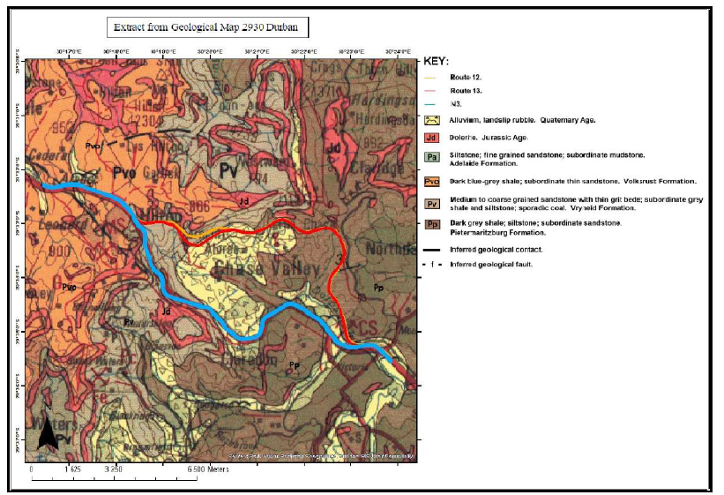
PART C4: SITE INFORMATION
SITE GEOLOGY

Slide 62
PART C4: SITE INFORMATION
Site Access & Environmental Requirements
Contractor responsible for constructing access roads to testing locations
Access support provided via SANRAL Project Liaison Officer
Access Conditions
Sites generally accessible via:
  Road reserves
  Existing farm tracks
  Tracks within Ferncliff Nature Reserve
Additional access tracks or gates may be required
TLB / excavator equipment allowed for access preparation

Slide 63
PART C4: SITE INFORMATION
Environmental Controls
Minimise vegetation clearing and environmental damage
No clearing of trees or bush without Engineer approval
Limited bush clearing allowed where necessary (included in rates)
All disturbed areas must be rehabilitated before site exit
Contractor Responsibilities
Provide a detailed access methodology
Obtain signed site acceptance letters from property owners after work completion
Stakeholder Coordination
Access consent already secured from landowners
Contractor will receive:
  Consent forms
  Property owner contact details
Introductory meetings to be arranged before site access

Slide 64
PART C4: SITE INFORMATION
Transportation of Samples & Core Boxes
Permanent storage details to be provided to the Contractor
Provision included for transport to SANRAL storage facility (Camperdown)
Contractor Responsibilities
Transport all samples and core boxes to the designated laboratory
Ensure transport is completed after each drilling site is finished
Samples must be delivered for material testing and analysis

Slide 65
PART C4: SITE INFORMATION
Contractor’s Camp Site
Contractor to arrange own campsite in accordance with specifications
Must assess site security risks and include provisions (e.g. security guards) in rates
Approvals & Permissions
Campsite location requires:
  Engineer approval
  Landowner permission

Slide 66
PART C4: SITE INFORMATION
Accommodation of Traffic
Traffic management to comply with:
  COTO Draft Standard (Section 1.5)
  SA Road Traffic Signs Manual (Vol. 2, Chapter 13)
Operational Requirements
Coordination required with Road Routine Maintenance (RRM) contractor
No inspections or investigations allowed without RRM support
Safety Considerations
RRM assistance required for:
  Safe movement through site
  Protection during intrusive or out-of-vehicle investigations

Slide 67
PART C4: SITE INFORMATION
Broad-Based Black Economic Empowerment (B-BBEE) Requirements
SANRAL is committed to implementing Government transformation policies
Contractors must align with B-BBEE objectives and requirements
Key Requirements
Adherence to Reconstruction and Development Programme (RDP) and related policies
Promotion and support of Targeted Enterprises
Implementation of engineering skills training programmes
Use of labour-intensive construction methods
Engagement with community-based structures

Slide 68
PART C4: SITE INFORMATION
Environmental Management
Contractor must follow an Environmental Management Plan in line with Section 41 of the Standard Specifications
Key Responsibilities
Minimise environmental impact during all activities
Ensure full compliance with environmental requirements and standards
Compliance & Penalties
Non-compliance will result in:
  Corrective measures, and
  Associated cost liability as defined in the specifications

Slide 69
PART C4: SITE INFORMATION
Occupational Health & Safety Management
Contractor must carry out all activities in a safe manner
Ensure no health risks to staff and labour
Compliance Requirements
Must comply with Section 40 of the Standard Specifications
Requirements aligned with the Occupational Health and Safety Act

Slide 70
Provisional Sum Items (BOQ)
Setting Out & Survey
  Establish survey control and site layout
  R200,000
Logging & Profiling
  Specialist geotechnical interpretation
  R1,750,000
Laboratory Testing
  Soil and rock testing
  R2,300,000
Seismic Survey
  Geophysical investigations
  R3,000,000

Slide 71
COMMON ERRORS
41

Slide 72
COMMON ERRORS THAT MAY LEAD TO NON-RESPONSIVE TENDER
BIDDER TO AVOID THE FOLLOWING COMMON ERRORS:
Submitted Sworn Affidavits:
  Without financial year indicated
  Different dates by deponent and commissioner
  SA based on irrelevant B-BBEE codes (CONSTRUCTION SECTOR)
  Unsigned SA affidavits by the commissioner of oath or deponent
B-BBEE CERTIFICATES:
  Submission of a certificate based on Old/repealed Codes
  Expired B-BBEE Certificate
  Certificate issued by an accountant or an Auditor
  Certificate issued by an Agency not accredited by SANAS
  Status level contradicts with revenue bracket

Slide 73
COMMON ERRORS THAT MAY LEAD TO NON-RESPONSIVE TENDER
BIDDER TO AVOID THE FOLLOWING COMMON ERRORS (continued):
Joint Venture submissions:
  Individual certificates instead of a JV B-BBEE Certificate
  JV B-BBEE Certificate submitted but the individual certificates are based on irrelevant codes
  Correct JV certificate but one of the partners is a Generic and the other an EME/QSE
  Project specific certificate not dated by the Commissioner
  4. Key Person and Firm Experience
  Incomplete D4 and/or D5 Forms –
    all data must be provided, including contact details, and must be legible
  Key Person experience is not relevant or does not match Tender Requirements
  Firm experience is not relevant and/or does not meet minimum Tender Requirements

Slide 74


THANK YOU
SANRAL web address: www.nra.co.za
SANRAL Fraud Hotline: 0800 204 558

