Slide 1
Office furniture
This document was produced to describe the proposed design elements and create a pallet for
each function. As a standardised pallet to ensure that a uniform precedent can be set across the
ACSA hierarchy, with a standardised approach to all new and refurbished offices projects.
Bidders are encouraged to use the Government Gazette (Vol. 483, September, No.27985) on norms and standards for office space planning These norms and standards are considered to be a good measure for internal space planning, providing sufficient space for the full range of office types and its associated accommodations.

Slide 2
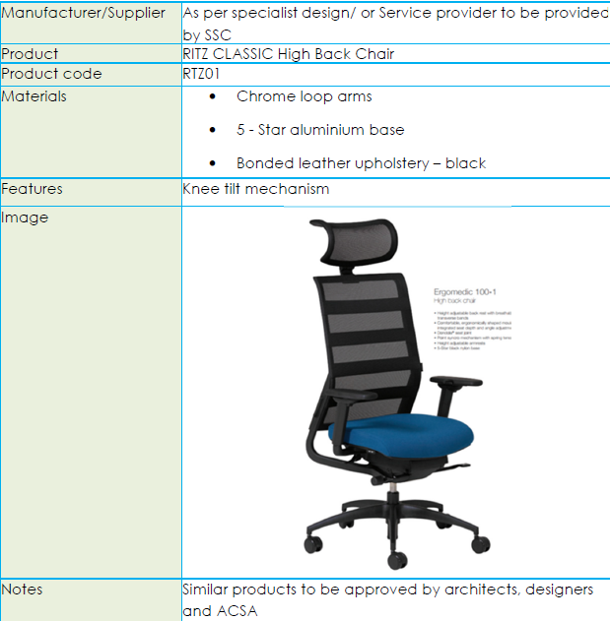
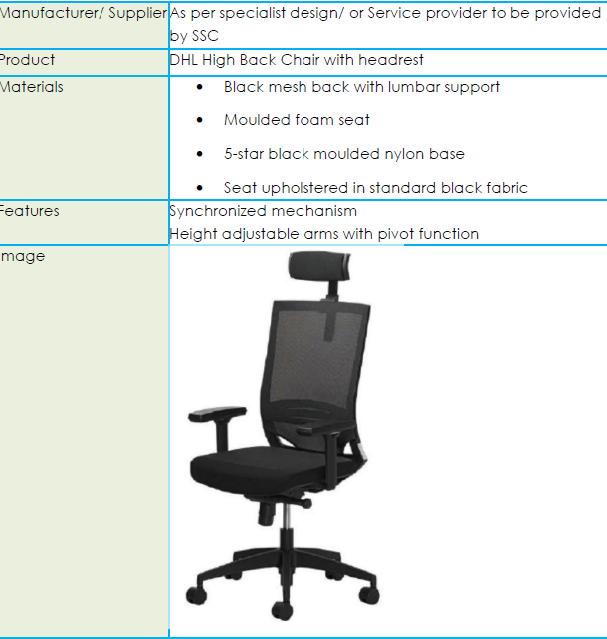
Boardroom & Office desk chairs
Office Desk chair

Slide 3
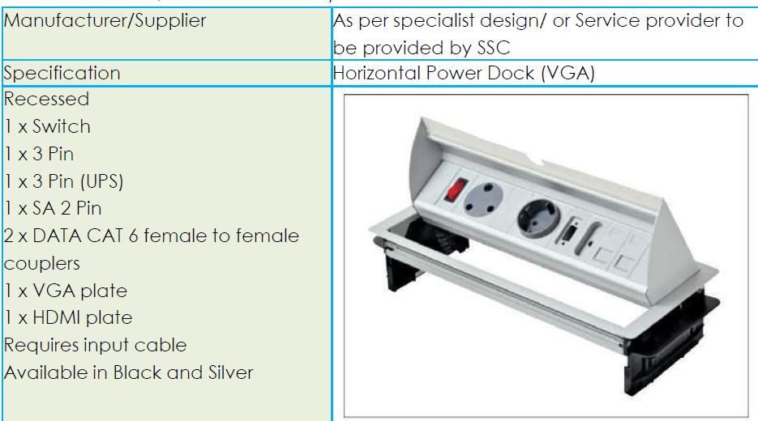
Boardroom
Power Dock for Admin Boardroom table

Slide 4
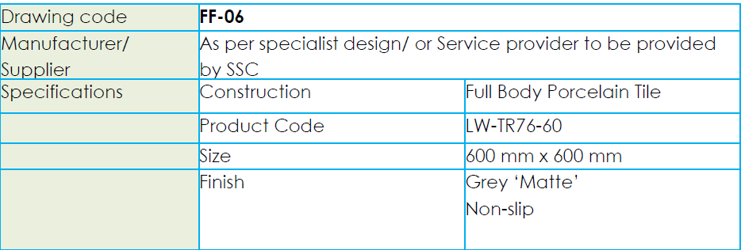
Tiles for kitchen/pause area
Kitchens and kitchenettes in pause areas will be finished in tile for a more hygienic and practical implementation.
Pause areas can have a more playful design approach for seating areas. This will distinguish area types from one another. Specific floor finishes selection will be done to avoid finished floor level variances where possible
Tiles must be suitable for a high traffic area.
Tile specification

Slide 5
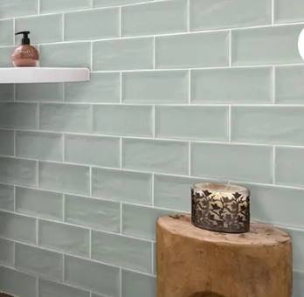
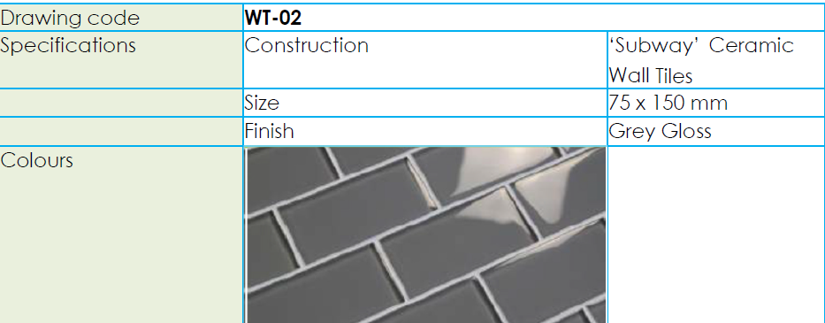
Wall tiles/Splash back
Proposed colours Grey /Aria green/white/ light grey

Slide 6
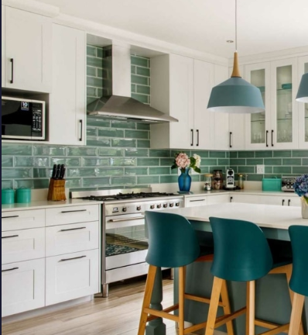
Kitchen top & wood
laminate countertops
Cedar/Pine Wood

Slide 7
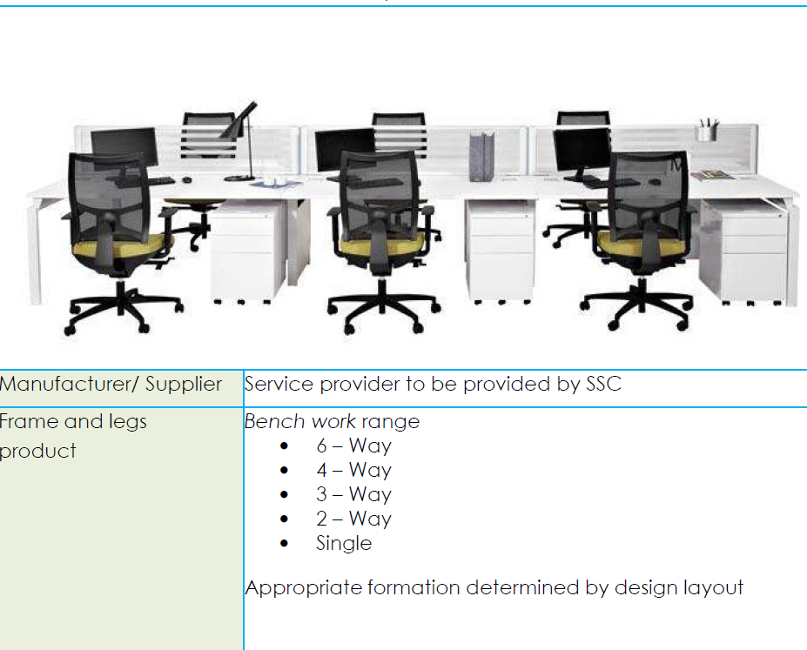
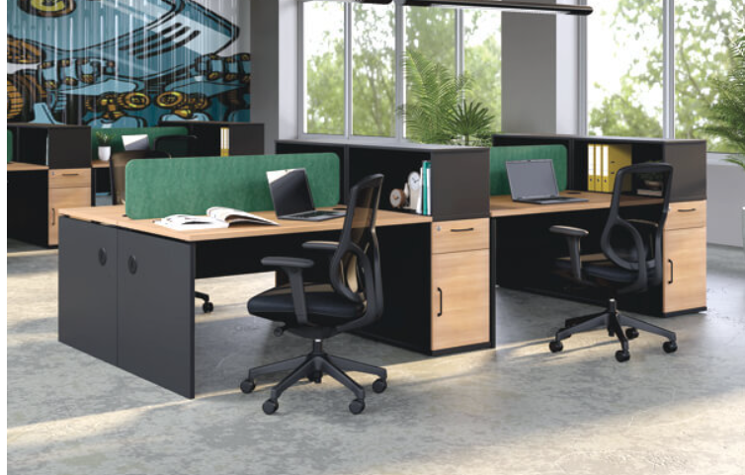
Open plan offices

Slide 8
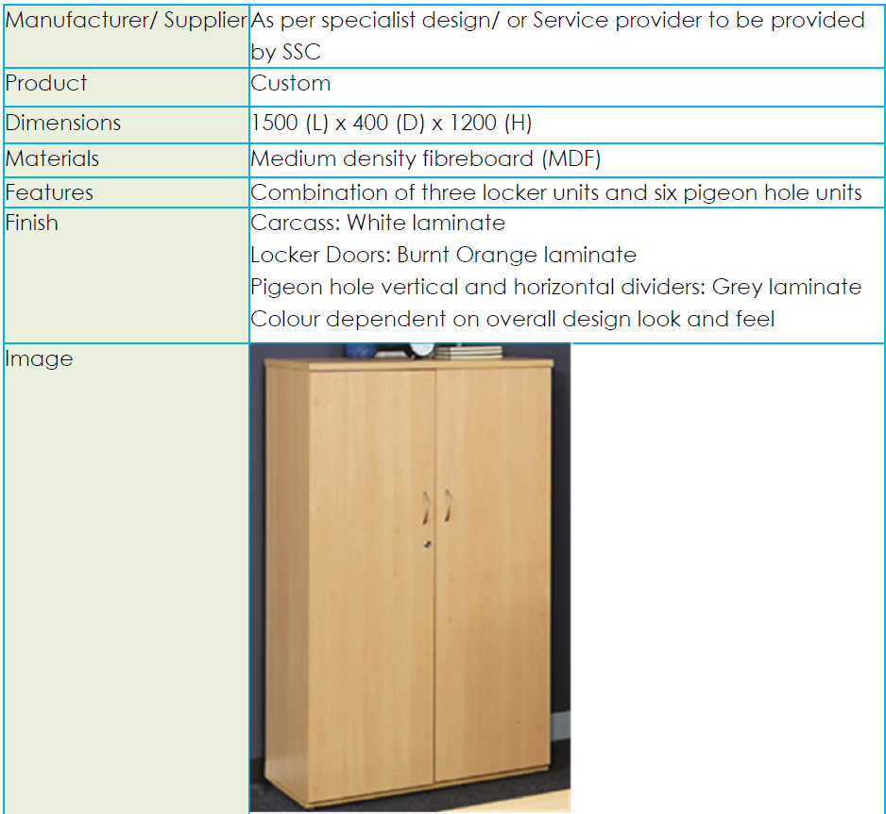
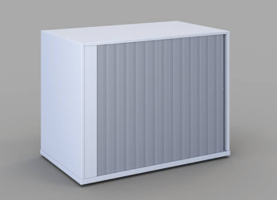
Storage
ROLLER DOOR CREDENZAS
Cabinets

Slide 9
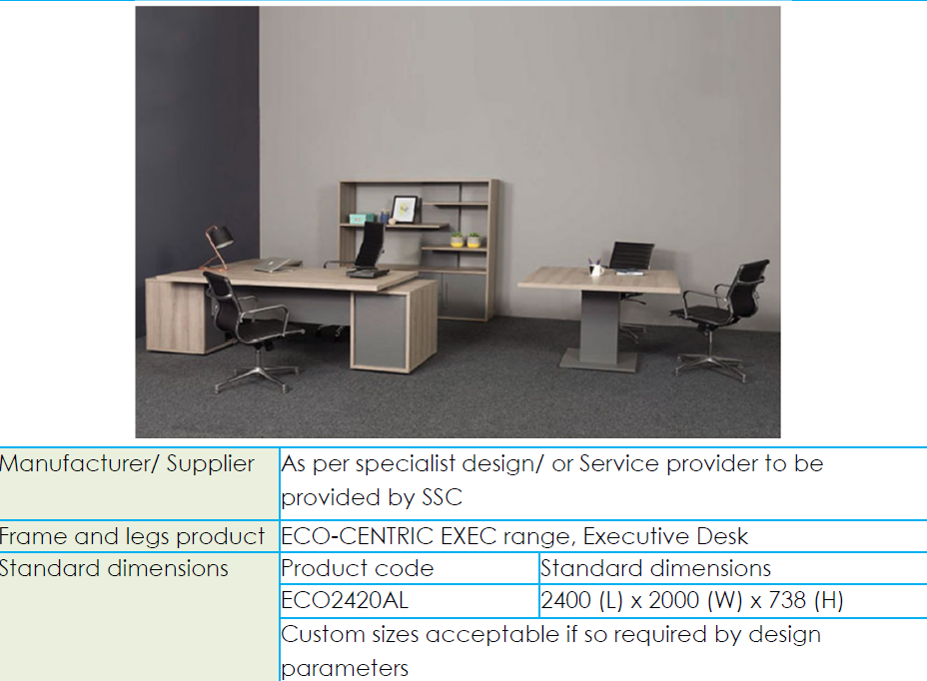
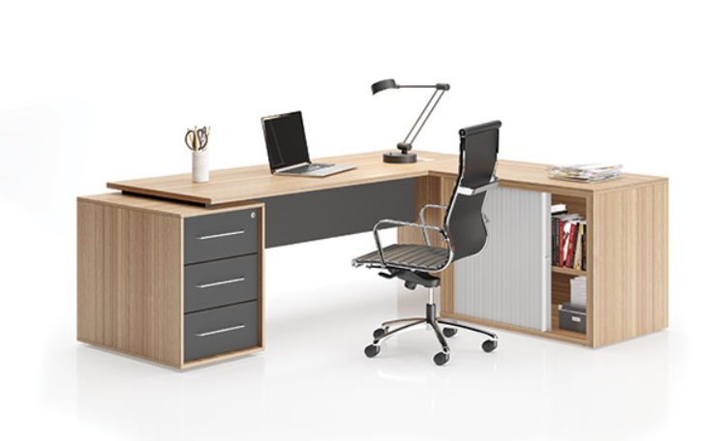
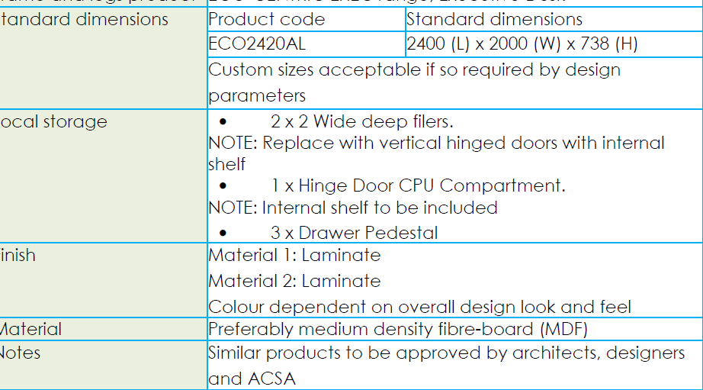
Office furniture
Technicians Desks

Slide 10
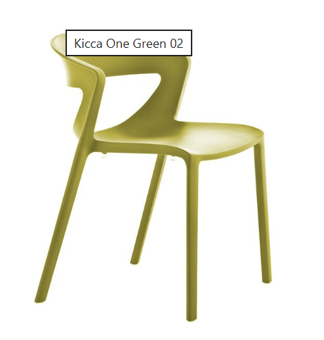
Staff rest room chairs

Slide 11
Electrical Appliances
Commercial microwave - Heavy-duty commercial microwaves (about 2000 - 3000+ watts)
Fridges 500 - 560L with water dispenser ; Energy Rating: A - Dimensions - Height:190.1 (CM), Width:91.2 (CM), Length:65.4(CM)
Bar Fridge (90L), Capacity: 90 Liters, Dimensions: H 850mm x W 480mm x D 450mm, LED illumination, Integrated handle, Reversible door, Adjustable levelling feet, Sealed crisper, Icebox, 2 shelves, 3 door racks
Four plate electrical stoves with oven. Must have a hob ,With 10 year guarantee
4 -Slice Sandwich Press ,2000 W. Floating hinge power and ready indicator lights, Non-stick plates. Auto thermostat control
Industrial washing machine ,Capacity | 20KG, Designed Life | 30'000 Cycle , Extraction | 450 G, Pocket Valve | Standard, Dimensions | 95x97x141 cm, Weight | 354KG
Water boilers for all kitchen areas, Including any required plumbing and electrical connection complete. Litres: 5, all mounted, Stainless steel or white epoxy casing, Instant boiling

