Slide 1
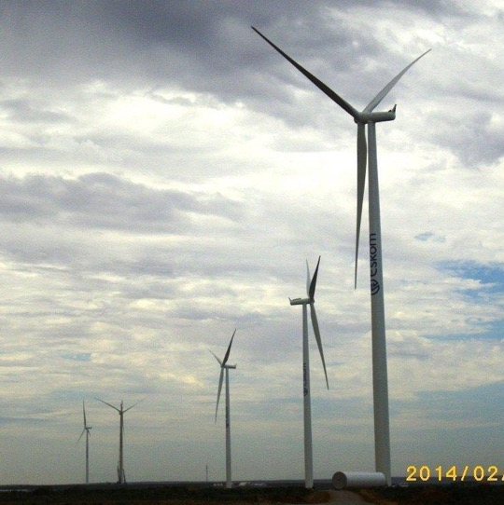
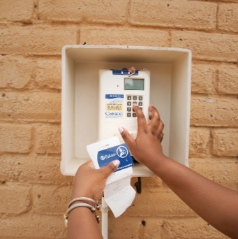
Eskom Distribution cordially invites you to the Smart Meter Suppliers Engagement Forum
Date : 24 January 2025

Slide 2
Supply of Smart Meters – Suppliers Engagement
MEETING GROUND RULES & OBJECTIVES– Commercial Representative/ Tshifhiwa
OPENING, WELCOME & EVACUATION ROUTE/ safety
Engagement Points:
Background for the need of smart meters
Commercial Requirements
Supplier Development Localisation and Industrialisation (SDL&I)
Technical Requirements
Safety, Health, Environment & Quality Requirements (SHEQ)
Financial Requirements

Slide 3
Supply of Smart Meters – Suppliers Engagement
Agenda
Time | Item | Details | Presenters
09:00 - 09:05 | Safety briefing | Safety Talk and House Rules | Bongi Sekano
09:05 - 09:15 | Welcome and Opening of Session | Welcoming guests and purpose of the engagement forum, Background for the Need of Smart Meters | Susan Mabena
09:15 – 10:00 | Commercial Requirements | Procurement Overview / Tendering Processes | Salebona Kutumela
10:00 - 10:30 | Tea Break
10:30 - 11:15 | Technical Requirements | Technical tender requirements | Edison Makwarela
11:15 - 12:00 | SDL&I Requirements | Supplier Development Localisation and Industrialisation | Yolisa/ Ayanda
12:00 - 12:30 | Tea Break
12:30 - 13:00 | Contract Management | NEC Contract | Donovan Kumkaran
13:00 - 13:45 | SHEQ | Safety, Health, Environmental and Quality | Andrew Else
13:45 – 14:00 | Financial requirements | Financial analysis | Jackie Spencer
 | Questions and Answers
 | Closing

Slide 4

Supply of Smart Meters – Suppliers Engagement
Welcome: Session Objectives
The session will focus on providing clarity on the, TEAP Process and tendering process which should assist prospective smart meter suppliers to submit responsive tenders that are commercially and technically acceptable.
We will endeavour to:
  Provide a guideline on commercial process
  Explain the evaluation criteria (Functionality)
  Explain the Objective Criteria's
  Provide a forum for Q & A and clarify any ambiguities

Slide 5
Commercial Process: Submission Requirements
  Updates & Clarifications: Tenderers are urged to continually check the Eskom Tender Bulletin and the National Treasury Website (e-Tender) for important updates pertaining the RFT in question i.e. minutes, notices, clarifications etc.
  Note: The RFT shall be submitted as 1 original pack plus 1 copy pack.(identical to the original). Failure to submit a copy will result in immediate disqualification.
  Note: Document must be clearly marked as original / copies
  Tenderers will not be permitted to provide the required copies after tender closing, and Eskom will not be responsible for the making of copies for the purposes of evaluation

Slide 6
Tender Info:
Tenders are to be delivered to the following address:
Eskom Holdings SOC Limited
Megawatt Park Tender Office, Northside
No. 01 Maxwell Drive
Sunninghill, Gauteng
CONFIDENTIAL ENQUIRY -1 Original / 1Copy
Tender Number: MWP2473DX
Description of Tender: TEAP PROCESS FOR MANUFACTURING AND SUPPLY OF SMART METERS FOR ALL DISTRIBUTION CLUSTERS FOR A PERIOD OF 3 YEARS ON AN “AS AND WHEN” REQUIRED BASIS.

Slide 7
Supply of Smart Meters – Suppliers Engagement
Welcome: Session Objectives
Welcome: Session Objectives

Slide 8
Supply of Smart Meters – Suppliers Engagement
QUESTIONS and Answers

Slide 9
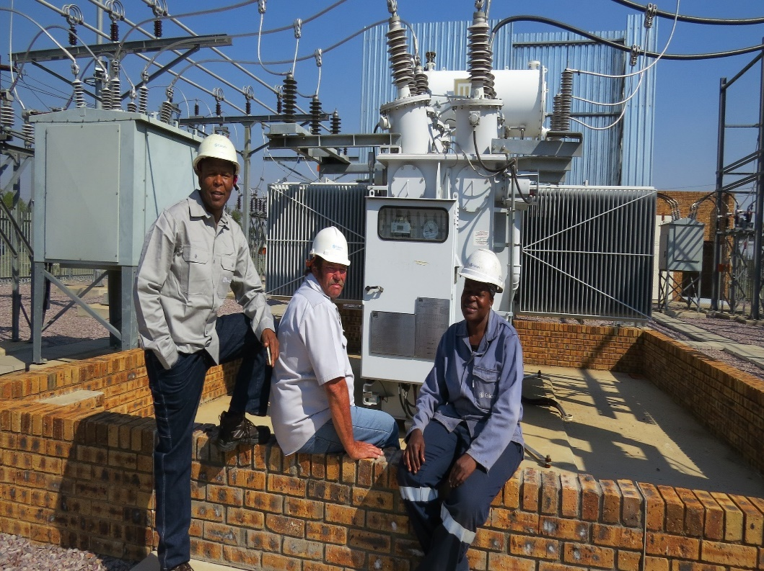
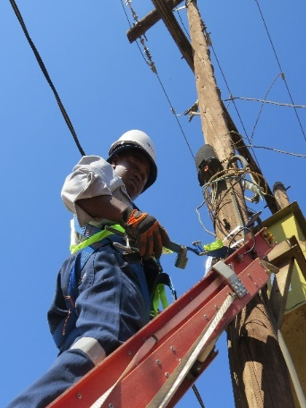
Thank you

